Slide 1
IP Phone(IP KTS) S/W Upgrade
Guide for IPECS MG System
EKR) R&D
Feb. 14, 2017

Slide 2
Upgrade procedure
Upgrade should be done as below 2 steps.
First step is Kernel upgrade. And then goes to Application upgrade.
Connect to MG System WEB Admin,
Choose S/W Upgrade
Kernel upgrade of target Phone by using MG system WEB Admin.
After completing Kernel upgrade,
the phone is reset automatically.
After completing Kernel upgrade,
goes to Application upgrade step
Application S/W upgrade by using MG system WEB Admin.
After completing Application upgrade,
the phone is reset automatically.

Slide 3
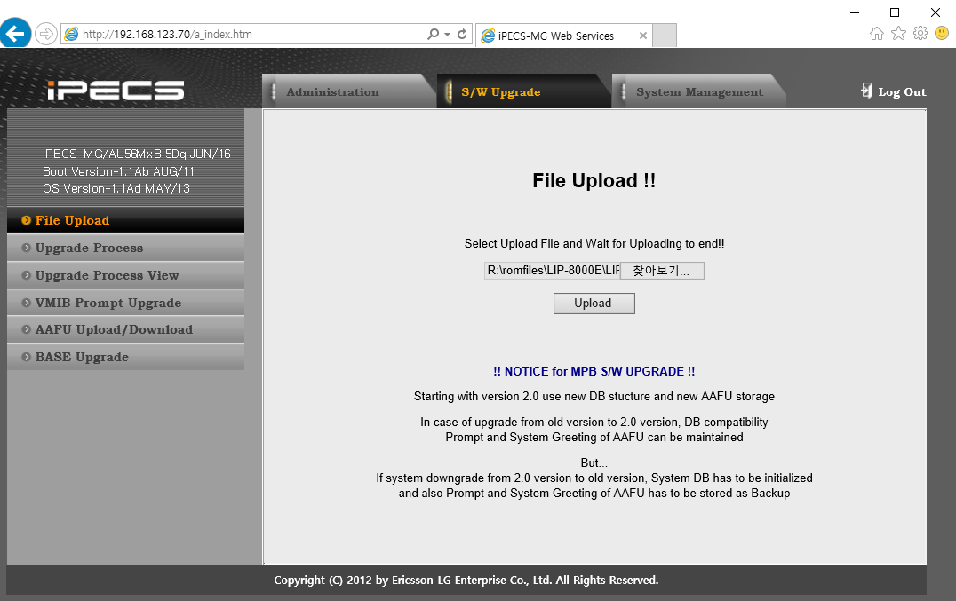
Kernel Upgrade
Boot upgrade via MG System WEB admin.
Boot file name is GS98P12Ab-kernel_8xxx.rom
Find the upgrade file.
Select folder and filename
and Press Upload button.

Slide 4
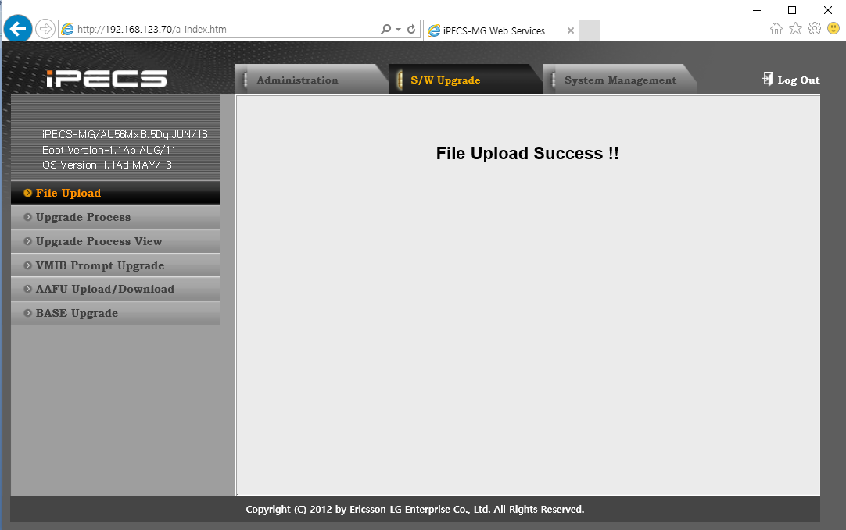
Kernel Upgrade
File Upload Success!! Means the kernel file is uploaded to MG
Next step is Upgrade process.

Slide 5
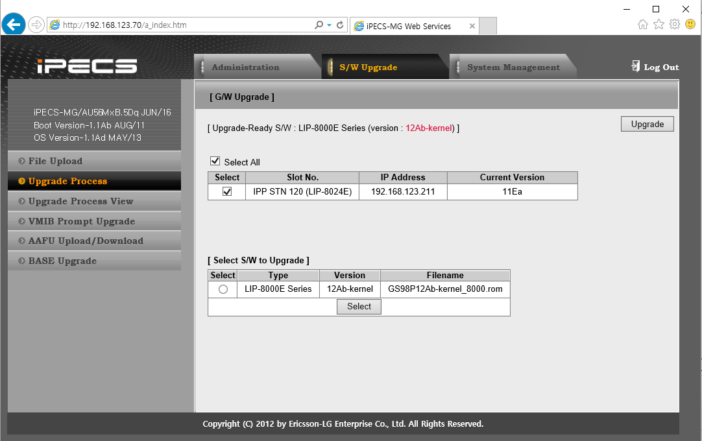
Kernel Upgrade
Press Upgrade Process, then, all stations are displayed that is related with uploaded file.
Select All, Press Upgrade button.

Slide 6
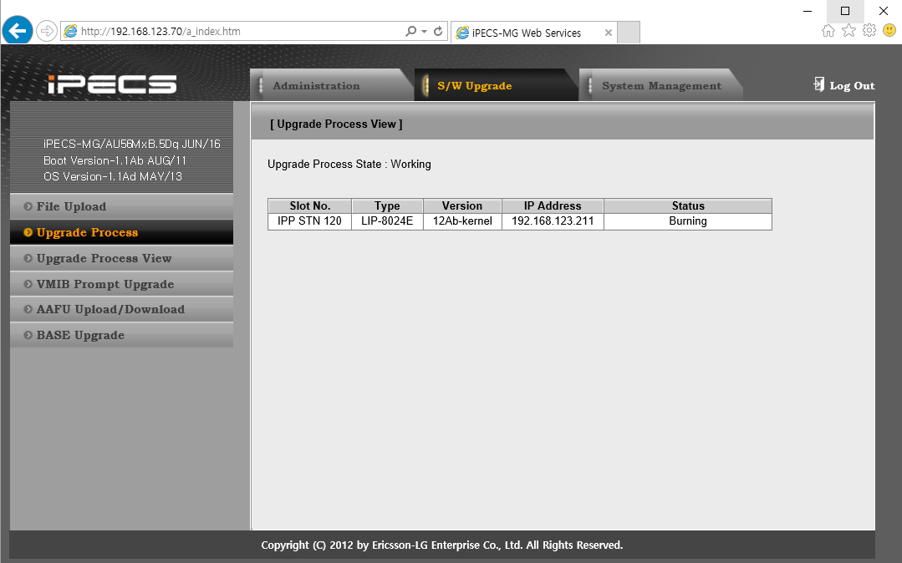
Kernel Upgrade
You can see the upgrade process [Start..0%..14%..100%.. Burning…Success]

Slide 7
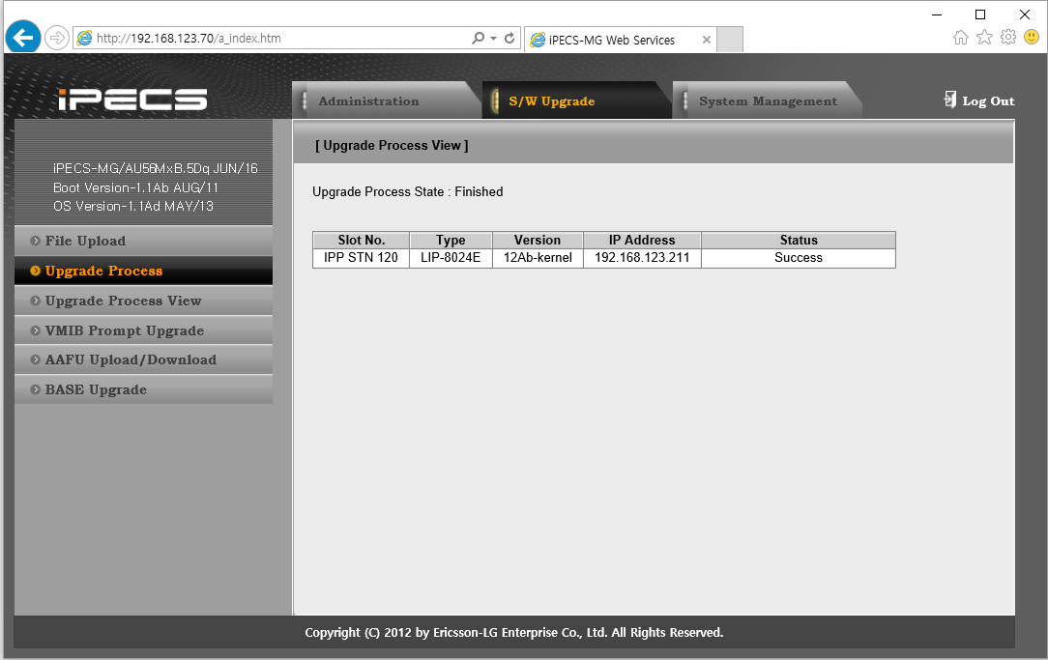
Application Upgrade
After Success, the 8xxxE phone is reboot automatically.
Check the phone is connected again, do upgrade Application file.
The process is same as Boot file upgrade : 3 page ~ 7 page.
Application file name is GS98P12Ab-app.rom

Slide 8
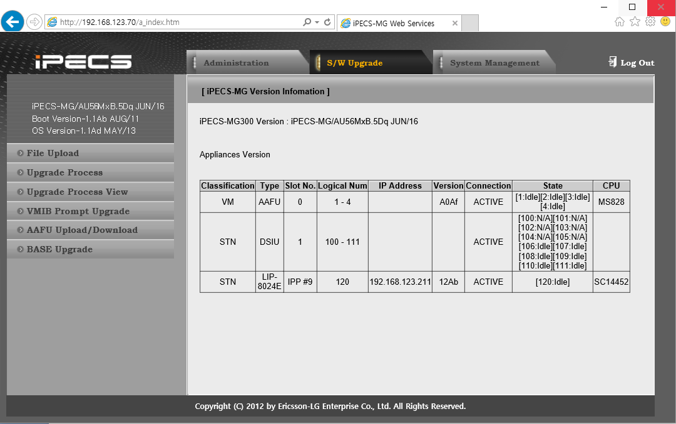
Check Version
After Boot & Application is upgrade is end, you can check the upgrade version as below.

