Slide 1
iPECS CCX / Report Plus v1.2 Introduction
Ericsson-LG Enterprise

Slide 2
Release history
What’s new
V1.2 Summary
V1.2 Enhanced features
V1.2 CCX Basic and option package change
License update
Appendix

Slide 3
Release history
Version | Major updates
v1.0 | Changed product name to CCX with Web based GUI (Agent, Dashboard)
v1.0Bc | CCX - IPCR Integration
v1.1Ac | CCX Report Plus (SMDR base, Unified/UCM) Enhanced features for CCX
v1.1Bb | CCX Report Plus (ACD version, Unified) CCX R+ - IPCR Integration
v1.1Cb | ECO package of v1.1B (Major issues fixed)
v1.1Da | ECO package of v1.1Cb with urgent problem fixed
v1.2Ab | New report generator and enhanced reporting features CCX Basic and option package change

Slide 4
What’s new
 | v1.0 | v1.1(v1.1Ac, v1.1Bb) | v1.1Cb | v1.2
Common Features for CCX & R+ | First package of new CCX Web based agent & dashboard HTTPS connection DB Expansion (64bits) Added .NET(DLL) as API IPCR integration(1.0Bc) | Official regular release Report plus features are included in the package | ECO of 1.1Bb package Master report Browser compatibility w/Chrome TTS in IVR(Portuguese) Dashboard live enhancement Agent statistics enhancement MS Windows Server 2019 | New Report Generator Enhanced Reporting features CCX Pulse (Monitoring services) Activity Tracker* Auto-Pause for call recording* Additional Browser Support CCX Desk web taskbar integration Software Assurance Expiry check
CCX only | HMP G.729 O-series only for recording New UI for CHAT Large package (~250 agents) | - | Web Callback in package Language portal upgrade | Basic and option package change
Report Plus only | - Not included in v1.0 pkg | SMDR features (1.1Ac) ACD features (1.1Bb) Web based ACD client (1.1Bb) | Manual update for ACD features Hot desk with 0xxx number
CCX Contact Center
CCX modules (option)
CCX Basic
CCX R+ Options
CCX R+ Basic
*Need license

Slide 5
V1.2 Summary
CCX v1.2
CCX R+ v1.2
Enhanced features for CCX and R+
New Reporting
CCX Pulse - Application and Service monitoring
Activity Tracker - Tracking agent desktop activity
Other notable updates
Auto-Pause for Call Recording
Additional Browser support
CCX Desk - Taskbar Integration
Software Assurance Expiry check
CCX CC package changes

Slide 6
V1.2 enhanced features for CCX and R+

Slide 7
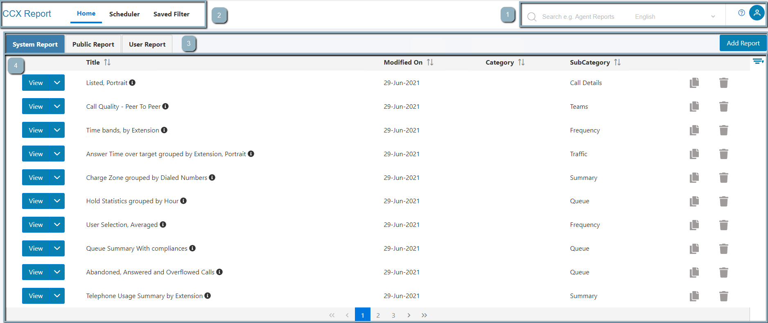
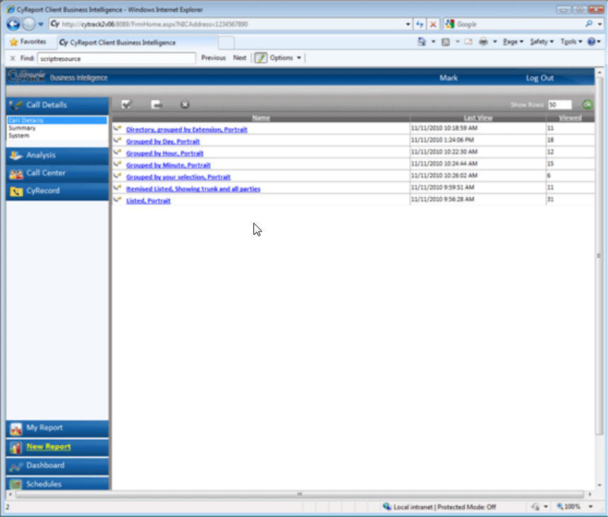
New reporting
Powerful and Intuitive New Report Generator
Editable inbuilt reports and flexible custom reports - modern, attractive reports and charts
Easy to build, easy to use with inline explanations for data elements and column
Enabling comprehensive and tailored analysis with powerful filtering – global filter and column filter
Enhanced reporting features – enhanced tracing of calls
2
1
3
4
Toolbar
Search, language selection, User guide, User Profile
2. Navigation Bar
Home, Scheduler, Filter(global)
3. Report Tabs
System Report (inbuilt report template)
Public Report (Shared report)
User Report (User specific report)
4. Page Body
V1.1
V1.2

Slide 8
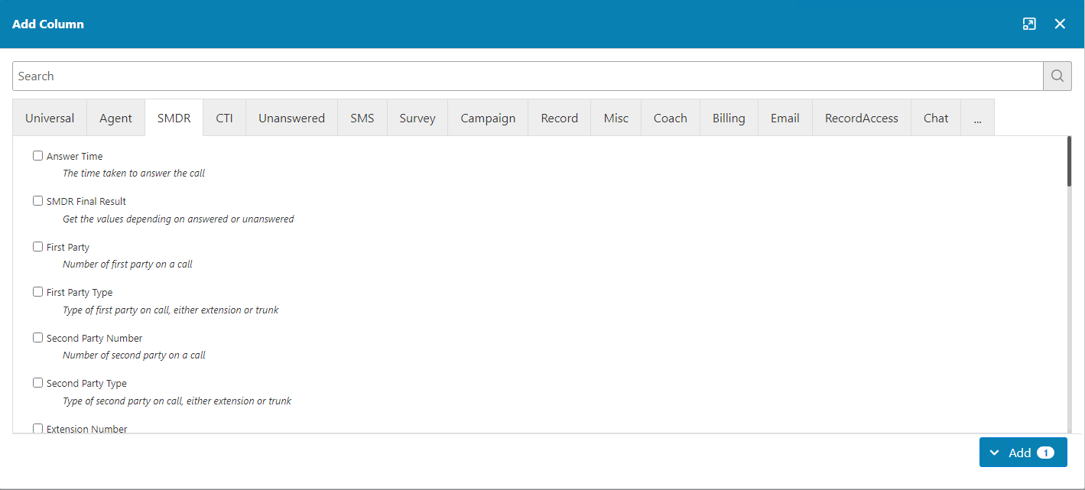
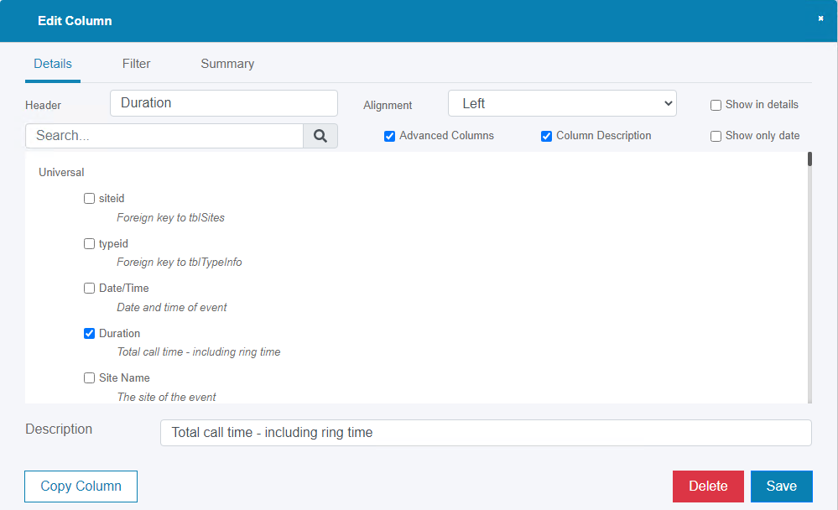
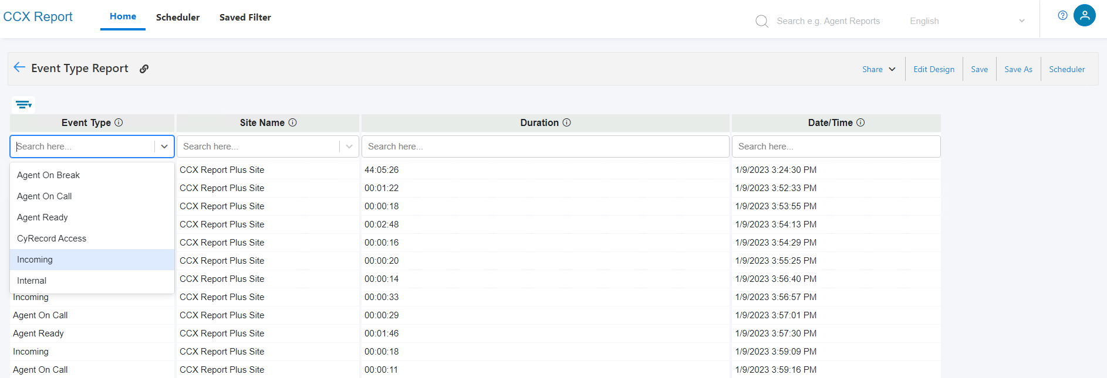
New reporting
Report Generator and Customization Tool
Easy to build, Easy to use with inline explanations for data elements and column
Enabling comprehensive and tailored analysis with powerful filtering – global filter and column filter

Slide 9
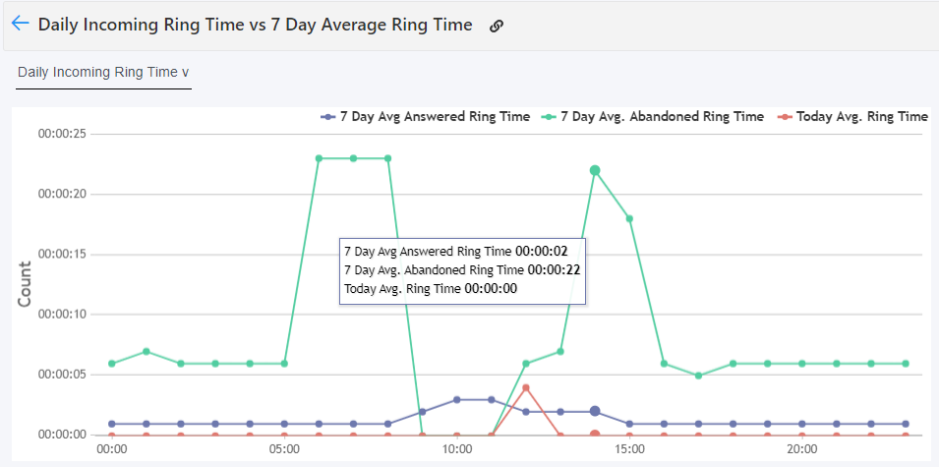
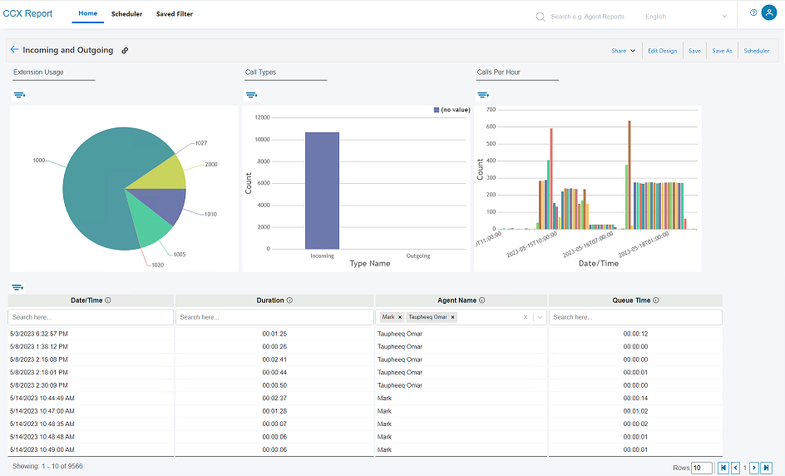
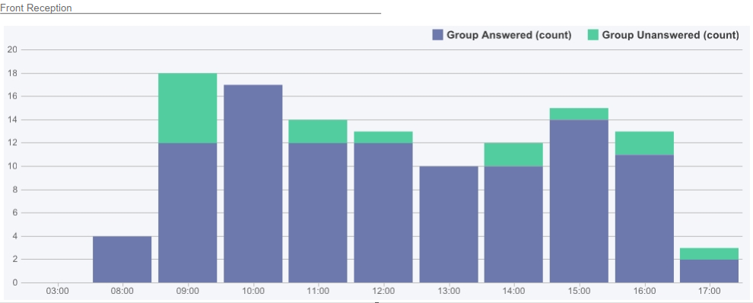
New reporting
Modern attractive Reports and Charts

Slide 10
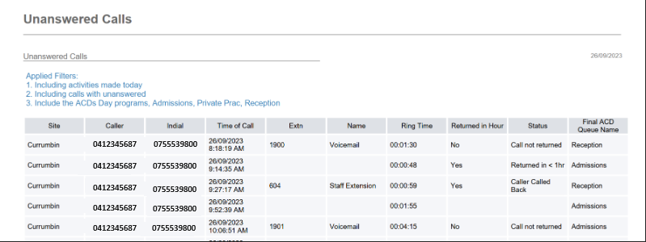
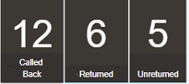
New reporting
> Enhanced Call Journey Report with CCX Q*
Enhanced reporting features
Enhanced Call Journey Report
Tracking of calls transferred to voice mail groups
Enhanced unanswered call reports and dashboards
Multiple IPCR recording files with hold, park in a linkage
* Not with UCP/eMG ACD and Ring Groups
> ACD Group Combo Box - Tracking of calls transferred to voice mail groups
> Enhanced unanswered call reports and dashboards
> Multiple IPCR recording files with hold, park in a linkage
Dashboard – unreturned calls per group for today

Slide 11
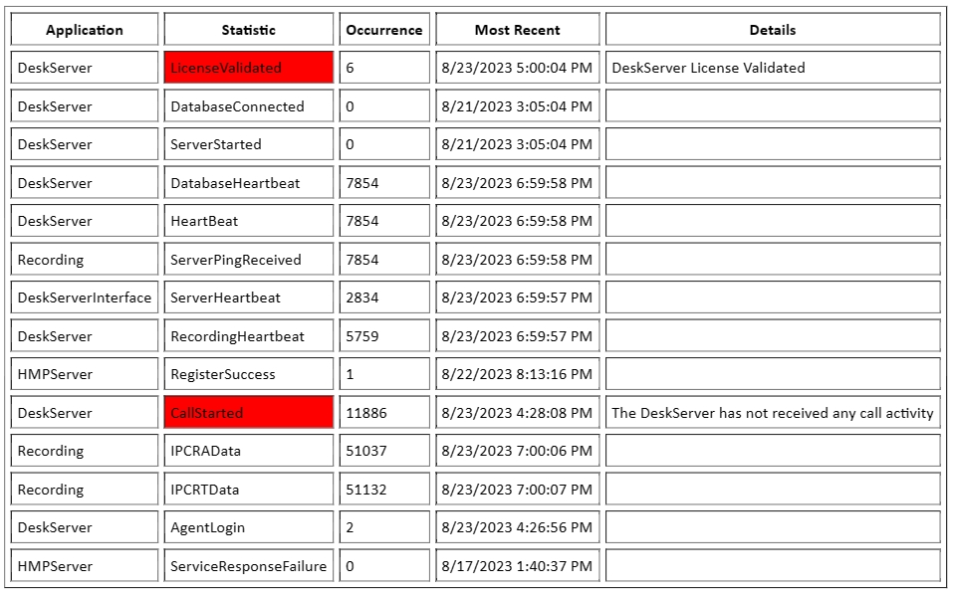
CCX Pulse
Application & Services monitoring solution
Monitors services in CCX and triggers alerts if any of them not working correctly
CCX Pulse alerts are sent to customer IT team, partner support center, or CCX Care Service Team
CCX Care service is an optional monitoring service (chargeable) and currently respond in real time in Australian times, outside of that will be next day
What can be monitored
CTI connection to PBX - CTI pulse not confirmed (disconnection)
SMDR connection - Configurable time since last call, Disconnection from assigned TCP/IP port
CCX Record service
Database Connection, Service is running, Time since last recording
The Recording ‘SizeMismatch’ looks for voice recording file sizes where the file size does not match what it should be compared to the length of the call data. This can occur if the recording is interrupted in some way part way through the call ‘Connection to DeskServer’
The ‘Recording SilenceExceeded’ call test that recordings do not exceed the expected percentage of silence (configurable by you)
Ability to poll relevant API, Disk Space, Time since last Ping from DeskServer
IPCR – Connection drop detection
> Per issue report at its occurrence
> Daily issue summary report

Slide 12
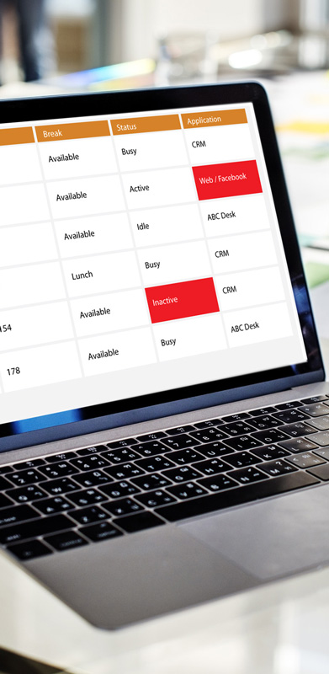
Activity Tracker*
Tracking agent desktop activity – improve productivity and security
Create a white-list of approved products for agents and staff
Reports time spent on unapproved websites, applications and even files/folders
Dashboard can display a list of agents, showing the present application being used and a red alert when not an approved application
Optionally set idle thresholds and provide an alert on the dashboard if agents are idle longer than their allotted time
Alerts can be colour changes on the dashboard, sounds, emails and or SMS’s to assigned parties
Real-time monitoring and historical reporting
* Per agent license is required - CCX Desk Activity Tracker (CX-DSK-ACTIV-TRK)

Slide 13
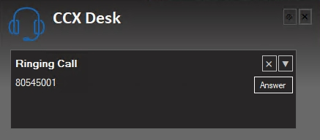
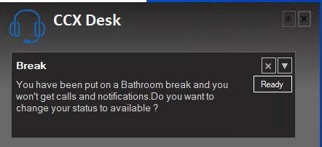
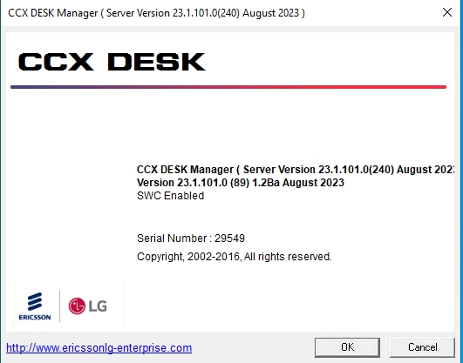
Other notable features
Auto Pause for Call recording | Agent can pause/resume recording by moving mouse position to inside or outside of agent workspace. When pause recording, sensitive data (ex : Credit card number) will not be recorded. | Per agent license is required (CX-AUTO-PAUSE, per agent)
Additional Browser Support | Official recommendation : Chrome, Edge
CCX Desk Taskbar Integration | Displays icon in Taskbar and pop-up notification (right bottom area in PC)
Software Assurance license check | Check whether their license is in-warranty or out-of-warranty by referring to the About screen * Consider to add the expiry date in the future version

Slide 14
CCX Basic and option package change

Slide 15
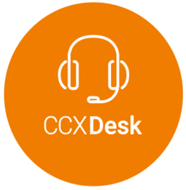
Basic and option package change
Introducing new modules while phasing out certain omni channel modules from V1.2
positioned as Customer Experience Contact Center Solution
~ V1.1
V1.2~
Basic Package
Basic Package
For new customers*
CCX Chat removed
Adding CCX Survey w/o additional price
No price change for basic package
For existing customers upgrading to V1.2
Not lose any licensed features from upgrading to v1.2
(3ch)
Optional Modules
Optional Modules
For new customers*
CCX Chat, Email, SMS, Social removed
For existing customers upgrading to V1.2
Not lose any licensed features from upgrading to v1.2
PICM
PICM
* omni channel services will be available directly from CyTrack via CyTrack’s Cloud subscription model

Slide 16
License update

Slide 17
License update with v1.2 (for new customers)
Basic package
Web chat removed. Instead, CCX Survey added without additional price
Options
Added Auto-Pause (CX-AUTO-PAUSE), Activity-Tracker (CX-DSK-ACTIV-TKR)
Removed CCX Chat, CCX SMS, CCX Social, CCX Email
30% of product price for software renewal fee under out of warranty
10% of product price for software renewal fee at the end of warranty
7% of product price for software renewal fee at the point of purchase
R+ to CCX upgrade license
UPG-CCX-PAK0
CCX-DSKCC-PK
(1xCCX CC, 1xCCX DSK)
*
+ H/W
*
+ H/W
Report add-on
Supervisor
Dashboard
Additional Ext. (100, 1000)
Extra site lic.
ACD Server lic.
CCX Pac add-on
Desk
HMP
Dashboard,
Extra site
CCX CC
CCX Q add-on
Callback
Email,VM,Fax
Social
CCX Record(PRI)
(4,8,12,16,24,30)
CCX Record(BRI)
(4,8,12)
CCX Record(VoIP)
(6,8,12,16,24,30,40,50,60,90
,120,150,180,200,240)
CCX Record IPCR integration
CCX Chat
CCX Call
CCX Survey
CCX SMS
CCX IVR
CCX Coach / Script
Auto PAUSE
ACTIVITY TRACKER
CCX R+ Basic
(100 Extension, 1xSupervisor, 1xDashboard)
CCX Basic Package
(CCX Desk, CCX Report, Dashboard, HMP, Queue Callback, Web Callback, Web Chat, Survey)
(5,10,20,30,50,75,100,150,200,250)
* H/W will be sent by C.O.D.(Cash On Delivery).

Slide 18
Appendix

Slide 19
Version Compatibility
> CCX/R+ vs Unified/UCM
 |  | Unified 3.0 | Unified 4.0 | Unified 5.0 | Unified 6.0 | Unified 6.1 | Remark
CCX 1.0 | CCX only | - | Y | Y | Y | Y
CCX 1.1 | CCX/R+ | - | Y | Y | Y | Y
CCX 1.2 | CCX/R+ | - | Y | Y | Y | Y
* Unified <-> CCX: TAPI, Unified <-> R+: SMDR (basic) / ACD&TAPI (option)
 |  | UCM 1.0 | UCM 2.0 | UCM 3.0 | UCM 4.0 |  | Remark
CCX 1.0 | CCX only | - | Y | Y | Y
CCX 1.1 | CCX/R+ | - | Y | Y | Y
CCX 1.2 | CCX/R+ | - | Y | Y | Y
* UCM <-> CCX: TAPI, UCM <-> R+: SMDR only
> CCX/R+ vs IPCR
 |  | IPCR 2.0 | IPCR 3.1 | IPCR 3.4 |  |  | Remark
CCX 1.0 | CCX only | - | Y | Y
CCX 1.1 | CCX/R+ | - | Y | Y
CCX 1.2 | CCX/R+ | - | Y | Y** |  |  | ** Need IPCR 3.4 to use Auto-Pause in CCX 1.2
* CCX <-> IPCR: Unified/UCM, R+ <-> IPCR: Unified ACD only

Slide 20
CCX / R+ overview updated with v1.2
CCX Report Plus (CCX R+)
Web based call reporting and simple CC solution
2 packages
SMDR version
Powerful call statistics and dashboard
Unified, UCM
ACD version
SMDR version
Real-time monitoring and reporting
Web based client for ACD agent
ACD log-on/off, Call control(make, answer, Hold, Park), CRM Int., Personal statistics,,,
IPCR call recording integration
Unified only
Upgrade to CCX with licenses
CCX Contact Center
IP Contact Center Solution
Basic package and option modules
Basic package
CCX CC, CCX Desk, CCX Report, CCX Report Generator*
Web Callback, Callback in Queue, Web Chat(3ch)*
CCX Pulse*, CCX Survey*
Option modules
CCX Call, CCX Record, CCX IVR
CCX Chat, CCX Social, CCX SMS, CCX Email*
CCX Coach, CCX Survey*
PICM
CCX Contact Center
CCX modules (option)
CCX Basic
CCX R+ Options
CCX R+ Basic
One software package for CCX & R+
Professional tech support via CCX Care
*Newly added or removed from v1.2, Applicable from new customers.

Slide 21
Thank you

