Slide 1
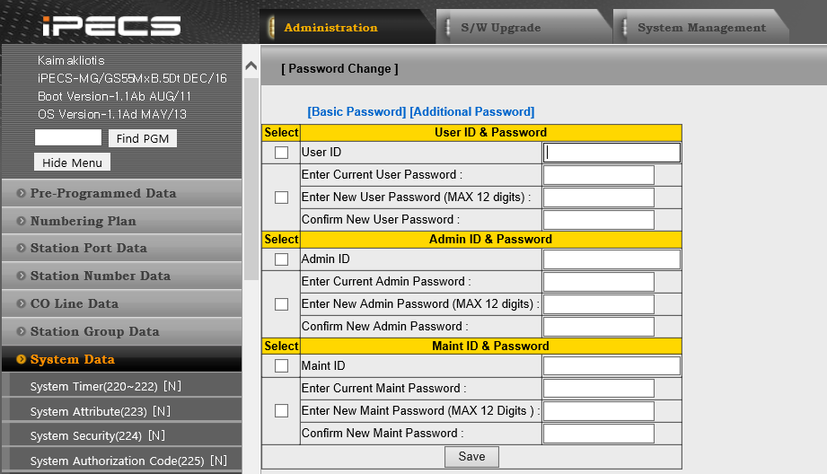
MG DB file and Web Access vulnerable
ACTION PLAN
Change current ID/Password of WEB admin (now, periodically)

Slide 2
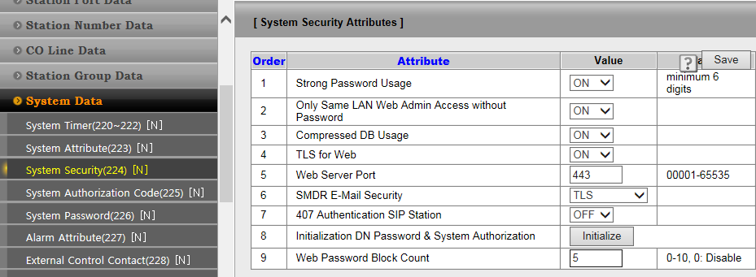
MG DB file and Web Access vulnerable
2. Enable DB compression(Encryption), TLS, Strong Password, Web Block
Strong Password usage : ON
Compressed DB Usage : ON (prevent to get the password from DB file)
TLS for Web : ON
Web Password Block Count : 5

Slide 3
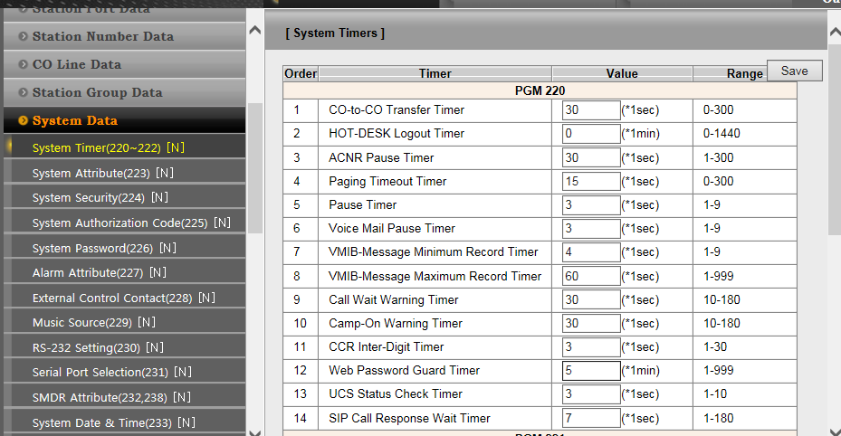
MG DB file and Web Access vulnerable
ACTION PLAN
3. Change Web Password guard timer to 5 min

