Slide 1
Unified SW V5.0 Introduction
Feb, 2021
Ericsson-LG Enterprise

Slide 2
Contents
Highlight
What’s new - summary
V5.0 major features
V4.1 major features
License update

Slide 3


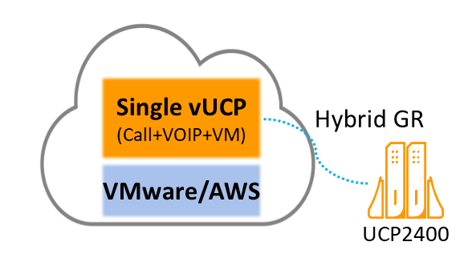
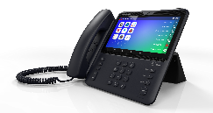
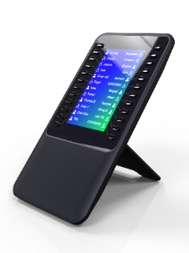
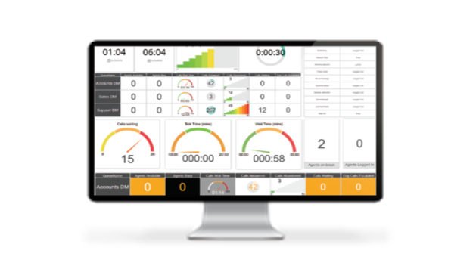

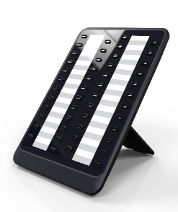






V5.0 highlight
Black items in Unified V4.1 Temp (available from Oct/2020)
Blue items in Unified V5.0 (To be available from Q2/2021)
Support enhanced versions of CCX, IP-ATD, IPCR, UCS
vUCP – Trial license, Single instance vUCP, Hybrid GR
Integration - MS Teams interworking and enhanced SMDR interface
Support 1048ilss/EHSA V4, 1080i, 1048idss
Support new UCP100/SLTM4/8/32
Enhanced features for usability, management, security, …
UCS 6.2*
UCP100/ New SLTMs
User Experience
Management
Security
Vertical markets
CCX 1.1B
1080i*
1048ilss
IP-ATD 2.7A
1048idss*
IPCR 3.2
EHSA V4
Trial license
Single Instance*
Hybrid redundancy*
NMS 2.1**
Web API / SMDR
Enhanced Apps
Virtual UCP
Integration
New terminals &
Accessories
Refreshed G/W &
Enhanced features
* Unified SW Phase 5
** iPECS NMS: EoS as of Dec/2020

Slide 4
What’s new - Summary
 | Unified v3.0 | Unified v3.1 | Unified v3.5 | Unified v4.0 | Unified v4.1 | Unified v5.0
UCS | v6.0 User base license Enhanced UX - Multi-login, Call log, IM continuity iOS Callkit support (iOS 10~) Push service for iOS/Android mobile Automatic failover to stand-by system in Geo-redundancy / T-Net environment (UCS Premium clients) On-demand call recording on mobile without MCIM resource Customization tool upgrade Flexible button window control option with main UCS window Search by name for non-UCS users | v6.1 AES encryption for GDPR v6.1 UCS premium server v6.1 UCS clients (Windows, Mac, iOS, Android) | v6.1+ TLS 1.2 support for port 7878/8899 | V6.1+ UX enhance (only with system S/W upgrade: Unified 4.0) Missed Call log sync Call forward only when UCS is out of service | V6.1+ Mac client Catalina OS support (Jun/`20) Android mobile client Android 10 support (Jun/`20) | V6.2 UCS Premium server iOS regular push support* iOS mobile client Support iOS regular push for IM/ notification* Mobile network IPv6 support** Mac client VPN support** Android mobile client Mobile network IPv6 support**
*Available with Unified SW V5.
**Not related with System SW version. Android/iOS mobile client IPv6 is only for mobile network IPv6, not for system/UCS server.

Slide 5
What’s new - Summary
 | Unified v3.0 | Unified v3.1 | Unified v3.5 | Unified v4.0 | Unified v4.1 | Unified v5.0
IP-Attendant | IP ATD/ATDH 2.4 Personal Group Support Call log sync | IP ATD/ ATDH 2.5 AES encryption for GDPR | IP ATD/ATDH 2.6A Call Control, Name sync, One-step LDAP Search, Search in monitoring window, Recall information V2.6B (May/2019) TAPI call control for IP ATD, GDPR option, Separate flexible button, LDAP (search base, more filed, call priority option) | V2.6C (Dec/2019) *¹ Call Server Geo Redundancy support (Dec/2019) | V2.7A (Oct/2020) Group setting (up to 100 per group) to reduce traffic PMS event save as CSV format Caller Name Display on Queued Group Call Hiding Auth Code Change folder for Outlook Contact Sync Add Wake-Up Type (Sun~Fri)
*¹ : Application features (not related with system SW).
These application software will be available as scheduled above.

Slide 6
What’s new - Summary
 | Unified v3.0 | Unified v3.1 | Unified v3.5 | Unified v4.0 | Unified v4.1 | Unified v5.0
CCX |  |  |  | V1.0 (Oct/2019, Unified 3.5+)
CCX R+ |  |  |  |  | V1.1B
IPCR |  | IPCR 3.0 support | IPCR 3.0+ HA HTTPS Local language | V3.1 (Sep/2019, Unified 3.5+) One-file call recording Delete registered agent Failover support for Call server Geo redundancy | V3.2 (Oct/2020) AWS support Recording cancel while auto call recording mode
NMS |  |  |  |  | V2.1 eMG100 1000i LDP-9200
3rd party Solution | New 3rd party PMS Interface*¹ Account code / Authorization code in ACD Manager Protocol*² |  | RESTful API*¹ SMDR Clickcall | Web API*¹ (Mar/2020) Call Control APIs Call Event APIs Flexible Page API SMDR print in JSON format via WebSocket ACD Manager Protocol print in JSON format via WebSocket | SMDR enhance SMDR - ICM missed call SMDR - Called/Connected Info SMDR - Group call information SMDR - Abandoned call info Web API enhance SMDR Web API - Call ID added
*¹ Need license (Refer to the details in license update section in the documentation)

Slide 7
What’s new - Summary
 | Unified v3.0 | Unified v3.1 | Unified v3.5 | Unified v4.0 | Unified v4.1 | Unified v5.0
New Terminals | LIP-9040C (IPKTS) – color phone Automatic failover to stand-by system in Geo-redundancy / T-Net environment (LIP-9000 F/W upgrade required) One touch manual profile switching (LIP-9000 F/W upgrade required) | Support AES encryption for LIP-9000/9071 |  | Support new iPECS IP Phone 1000i series 1010i/1020i/1030i/1040i/1050i 1024idss | 1048ilss EHSA V4 | 1080i 1048idss
Enhanced IP DECT/ DECT | DECT feature enhancement (UCP only) Remote monitoring of 480H/500H Idle roaming support between zone of WTIM24 and zone of WTIM4/8 | Support UCP-WTIM24 for eMG800 | Support new IP-DECT bases and handsets | Support essential system features System directory support Call Server failover support Hotel check-out text message notify Call Back Alarm message integration (direct integration needed between alarm server and IP-DECT)

Slide 8
What’s new
 | Unified v3.0 | Unified v3.1 | Unified v3.5 | Unified v4.0 | Unified v4.1 | Unified v5.0
Platform | Virtual UCP (vUCP, vVOIM, vUVM) E1R2 for Thailand/Brazil/ Argentina/Chile/Mexico UCP gateways can be installed behind NAPT / Failover support |  | New virtual call server license Support Amazon AWS Support new virtual gateways vMCIM Support virtual gateways for on-premise UCP call servers | Support vVOIMT (virtual transcoding gateway) for vUCP Kernel & Package upgrade for security enhancement for vUCP Call Server and gateways: vUCP / vUVM / vVOIM / vMCIM / vVOIMT vUCP VM message change (64K → 32K) | vUCP Support trial license | vUCP Single instance support (Call Server, built-in vVOIM/vUVM) Hybrid geo redundancy vMCIM V2 upgrade
Enhanced Voice mail | Allows multiple trials on password input error when voicemail retrieval. Upload user greeting (.wav) files via Web. | VM cascading option User greeting upload VM time mode synced to system time mode

Slide 9
What’s new - Summary
 | Unified v3.0 | Unified v3.1 | Unified v3.5 | Unified v4.0 | Unified v4.1 | Unified v5.0
Enhanced System features (1/2) | Enhanced UX Speed dial, Directory, Message, Missed call/Call back indication Call log management Improved terminology Visual VM for LIP-9071 Enhanced alarm/emergency features Automatic alarm call with announcement play (Internal and external) Automatic triggering of external relay Automatic paging triggering with alarm input Email notification to up to 10 email addresses Extended caller name display Receiver’s name display for pickup call Forwarder’s name display for forwarded call VM to email – Name display for intercom call Visual VM - Name display for intercom call | Normal paging volume control on a user basis ACD log-in group information Conference room Multi language on 9040C Background image change for 9040C | Support dual IP address for multihoming Enhanced emergency paging Phone lock / unlock Personal CCR for ICM call Differential Ring for station group “Barge-in” support during system call recording to VM (Need MCIM channels) “Barge- in” support when IPCR recording (Need MCIM channels) Improve MCIM channel management Networking support with UCP geographical redundancy case Support “auto idle” for Call log, TRANS, Speed, Menu, Dir, Msg Improve call log operation Call log support when Busy/DND/fwd to VM | UX enhance LIP-9000 LCD display - go back to default display page. UCS default ring tone change UCS missed call sync Easy and consistent alphabet input for name store and search Directory search: minimum 3 character → 1 / 2 characters Internal call hold / retrieve by other’s DSS button Enhanced Call Routing Add a direct recall option to block a blind transfer to a busy extension. Support Personal CCR when announce-only mailbox option is enabled. Support more CCR options for BUSY/ERROR/NOANS destinations same as options 0-9. When “FWD IF OOS” for UCS client is set, forward incoming calls only when an UCS client is out of service. Add an option to provide MOH to caller while group call ringing | UX and Call management Programmable MOH by station Transfer using DIR search Flexible paging from MEX Transfer to a station in DND/FWD Idle on Hold for CC agent Block transferring a call Ringback tone for group Multi barge-in conference

Slide 10
What’s new - Summary
 | Unified v3.0 | Unified v3.1 | Unified v3.5 | Unified v4.0 | Unified v4.1 | Unified v5.0
Enhanced System features (2/2) | Outbound PRI – Customized name presentation SMDR - Call info for incoming call to group EXEC/SEC with Call Forward – add new VM option Add an option to route calls to alternative destination when all ACD member is busy Add an option to route overflow calls to alternative destination when all members in ring group are busy and queue is overflowed. |  | Paging call log option Missed call log clear option Key pad tone on/off option CCR option for * and # Upload custom background color image for 9040C (Terminal feature) GCM → FCM | Hotel Features Create a wake-up group for wake-up call Hotel check-out text message notify (IP DECT) Headset button on/off option for guest room phone Room Status Change via a maid phone

Slide 11
What’s new
 | Unified v3.0 | Unified v3.1 | Unified v3.5 | Unified v4.0 | Unified v4.1 | Unified v5.0
Enhanced Security | Access control option to Menu / PGM button Secure Hash Algorithm is changed from SHA1 to SHA2 Added default value for Station COS (for requesting countries) Added default value in allow/deny table as for white-list / black-list (for requesting countries) Leave change log for security related settings. | AES encryption for database (default off) AES encryption for voicemail recorded file (default off) | Strong user password for station web access and clickcall New license file support (encrypted by RSA2048) | UCS Premium - Separate UCS Web Admin Port and Data transfer protocol port for client. Add an option to show the station number instead of MEX mobile number to caller. Allow the SIP license registered for IPCR to be used only for IPCR. Standard SRTP for UCP Gateway using 256 encryption key Add an option for Remote Web Access Block for UCP Gateway | Web/Telnet enable/disable SMTP password digit increase DSS LED service for specific users
Management | Web admin enhancement for LDAP attributes Preset Flexible button is also supported for UC client | Trace route tool Web trace option More email alarm notification DECT phone monitor | Alarm notification support for geographical redundancy failover case | System Performance Status Display Packet capture for virtual gateways Web GUI to back-up voice mail greetings and messages (vUCP/eMG100) SIP Domain Name length (48 → 64) | Programming in excel style eMG800 time slot full alarm Decimal digit for mini-bar charge License for 3rd party coloring UCP100 SLIU disable option eMG800 ISDN clock sync
Software Assurance | Newly allowing system attendant to make an outgoing call in limited service mode. |  |  | Virtual UCP Only annual renewal with MNT1 .no multi year renewal → Removed MNT2~5 .Out of warranty below 5Y: doubled price .Out of warranty above 5Y: 100% of lic+MNT1 MNT1 step pricing by license portal (7 steps by port range)

Slide 12
Unified V5.0 - major features

Slide 13


vUCP enhance – Single Instance vUCP (1/2)
(Unified V5.0)
Adding single instance vUCP for cost reduction and simple deployment
  Single instance vUCP supports up to 600 system ports. (w/ built-in vVOIM/vUVM gateways)
  Expandable up to 2,400 system ports with external gateways. (w/o built-in vVOIM/vUVM gateways)
  Same vUCP licenses are commonly used for single instance/multi instances vUCP.
Multi Instance installation (~V4.1)
System Port: up to 2,400port
External virtual gateways
Single or multi instance installation (V5~)
Single Instance: up to 600 system port w/ built-in g/w
. Built-in vVOIM (default 6ch → up to 128ch
. Built-in vUVM (default 8ch → up to 64ch)
- Multi Instance: up to 2,400 system port w/o built-in g/w
Up to 2,400ports
vUCP CS
vUCP CS
Up to 600ports
vUCP CS
vVOIM
vUVM
vMCIM
vVOIMT
vVOIM
vUVM
vMCIM
vVOIMT
vVOIM
Disable
vUVM
vVOIM
vUVM
vCore
vCore
vCore
vCore
vCore
vCore
vCore
vCore
vCore
vCore
vCore

Slide 14
vUCP enhance – Single Instance vUCP (2/2)
(Unified V5.0)
Installed vUCP (below 600ports) can migrate to single instance vUCP
Single instance vUCP can be expandable above 600ports
Multi virtual instances
(~ Unified SW V4.1)
Single / Multi virtual instances
(Unified SW V5.0~)
Below 600 system ports
Up to 600 system ports
Up to 128 vVOIM channels
Up to 64 vUVM channels
Add external virtual gateways
601~2,400 ports
Only with external gateways
2,400
ports
2,400
ports
Below 600ports
Reinstallation
DB adjustment
License transfer required*
600ports
Above 600ports
Disable built-in vVOIM/vUVM
DB adjustment
248ch
248ch
144ch
128ch
External
Virtual
Gateways
144ch
64ch
50ports
6ch
8ch
50ports
6ch
8ch
50ports
6ch
8ch
vUCP CS
vVOIM
vUVM
vUCP CS
vVOIM
vUVM
vUCP CS
vVOIM
vUVM
Multi instance vUCP
Single Instance
Multi instance vUCP
* License transfer is required with new vUCP S/N from re-installation.

Slide 15
vUCP enhance – Hybrid Geo-Redundancy
(Unified V5.0)
Enhancing flexible and reliable deployment options by supporting Hybrid Geo-Redundancy
  Installed UCP600/2400 can be re-used as stand-by server (UCP licenses can’t be re-used to vUCP.)
vUCP Geo-Redundancy
(Unified SW V4~)
Hybrid Geo-Redundancy
(Unified SW V5~)
vUCP CS
vUCP CS
vUCP CS
vCore
vCore
vCore
UCP600/2400
Stand-by
Active
Stand-by
Active
Built-in vVOIM/vUVM can be used only with UCP600 (below 600ports)
Built-in GW can’t be used for UCP600/2400
UCP600/2400 SW needs to be upgraded to V5.0 as well.

Slide 16
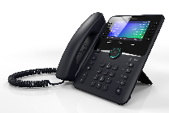
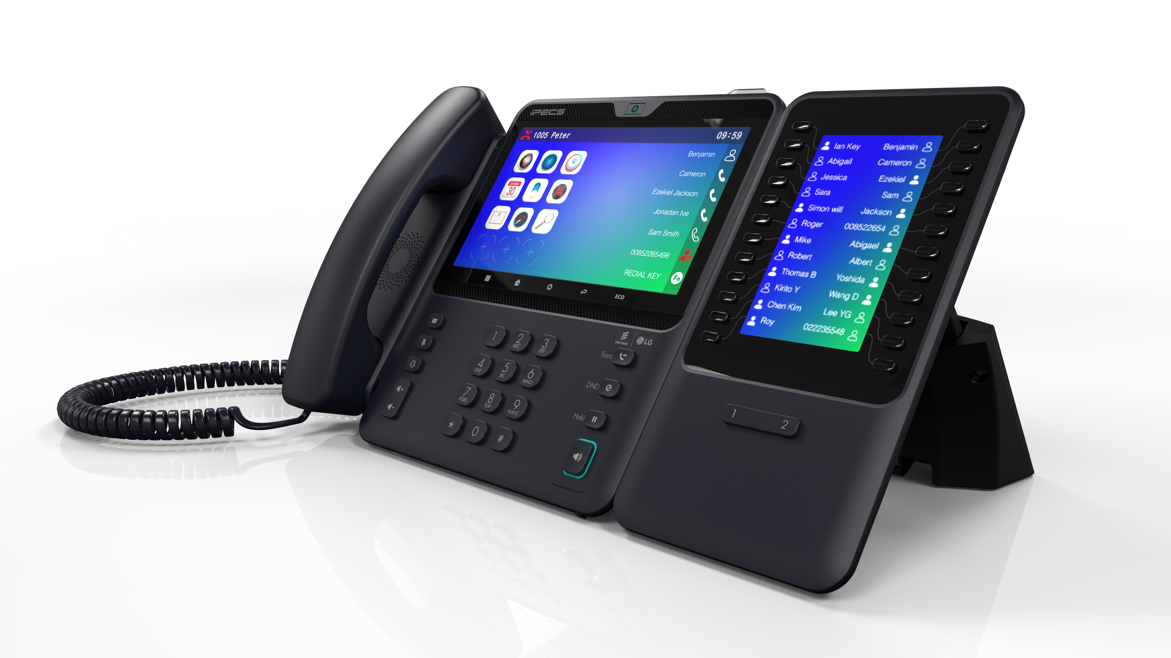
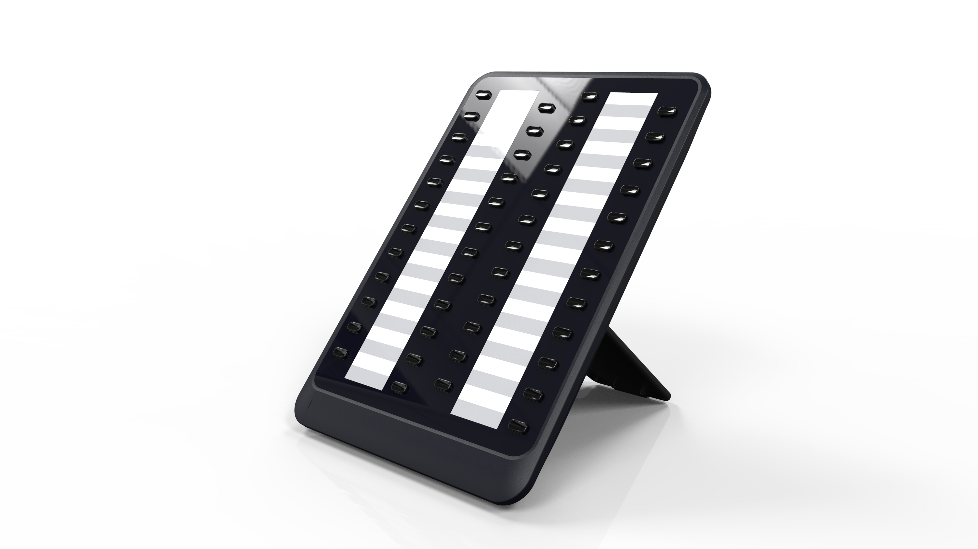
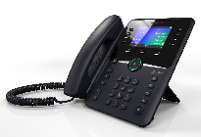
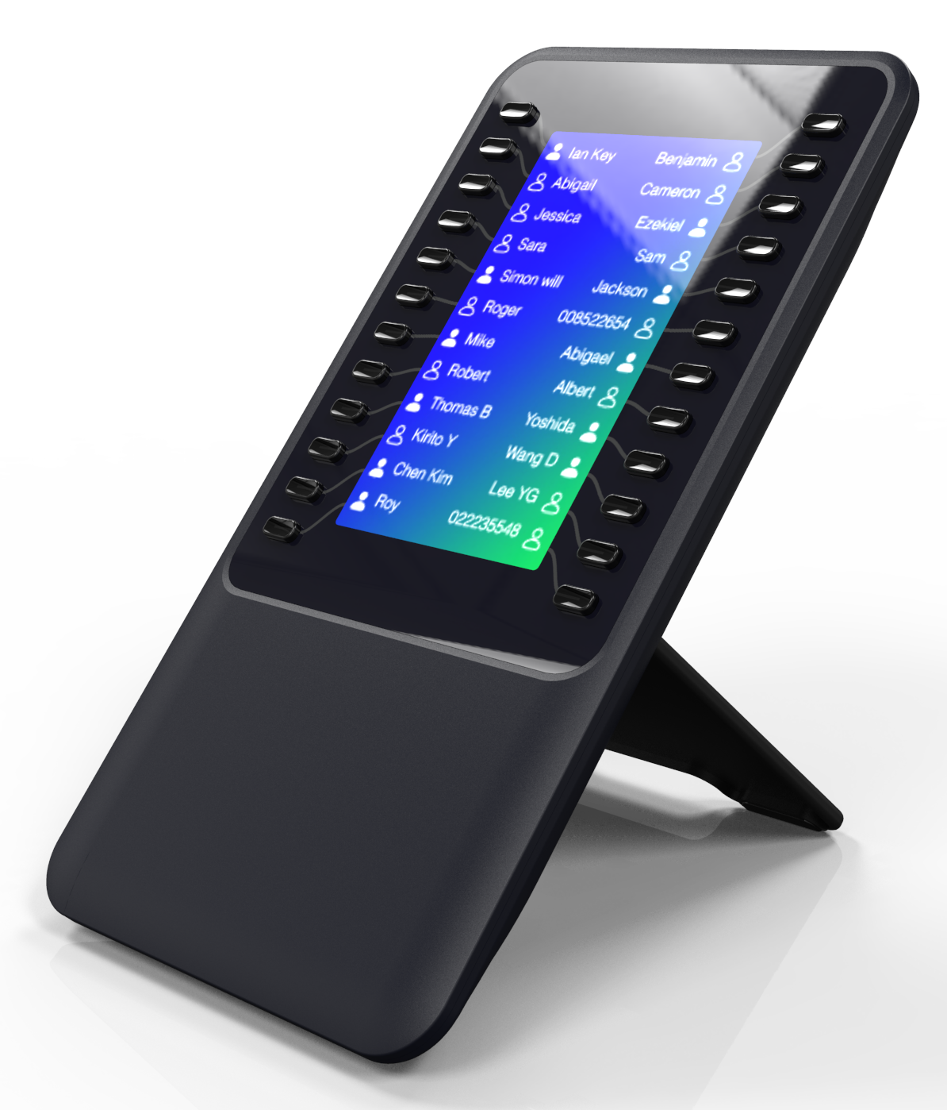
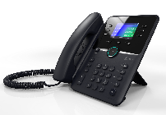
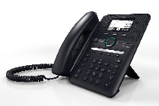
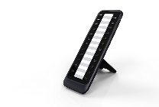
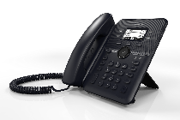
1000i support
(Unified V4.1/5.0)
Supporting 1080i, expansion modules and accessories
Unified V4.0
Unified V4.1
(Oct/2020)
Unified V5.0
1050i (4.3”)
EHSA V4
1040i (3.5”)
1048ilss
1080i
Android 10 OS
7” Touch screen LCD
Built-in WiFi (802.3b/g/n/ac)
Built-in BT (BT 5.0)
8M pixel camera for video
HDMI, USB, Analog headset port
Simple foot stand
1048idss
48button paper DSS
Up to 4 ea per phone
1020i/30i/40i/50i/80i IPKTS
1030i (2.8”)
Color LCD DSS
24 button x 2 pages
Up to 3 ea per phone
1020i/30i/40i/50i/80i IPKTS
1020i (2.8”)
1010i (2.4”)
1024idss
EHSA V3

Slide 17



Enhanced applications
(Unified V4.1/5.0)
Support enhanced applications with enhanced UX, management and Security features
UCS 6.2 | IP Attendant 2.7A | CCX 1.1B | IPCR 3.2 | NMS***
UCS Premium server iOS regular push support* iOS mobile client Support iOS regular push support for IM/notification)* Mobile network IPv6 support** Mac client Catalina OS support (Jun/`20) VPN support** Android mobile client Android 10 support (Jun/`20) Mobile network IPv6 support** | Feature enhancement Group based monitoring (up to 100 ext.) to reduce traffic PMS event log save as CSV format Caller Name Display on Queued Group Call Change folder for Outlook Contact Sync Password hide | Integration support for CCX Report+ | Integration support for IPCR on AWS Feature support Recording cancel while auto call recording mode | Support new system/ devices eMG100 1000i LDP-9200
*Available with Unified SW V5
**End Q1/2021. Not related with System SW version. Android mobile client IPv6 is only for mobile network IPv6, not for system/UCS server.
*** EoS in Dec/2020
Notes:
Continue to support and enhance mandatory features like UX, management, security, OS update, IT/network environment change.
UCS
Supporting regular push in iOS. iOS client and premium, standard UCS servers updated.
Mac client VPN is supported now.
Some mobile network IPv6 only. iOS and Android to support.
IP Attendant 2.7 A
CCX Report Plus
IPCR V3.2 support AWS
NMS: EoS since browsers don’t support flash anymore

Slide 18
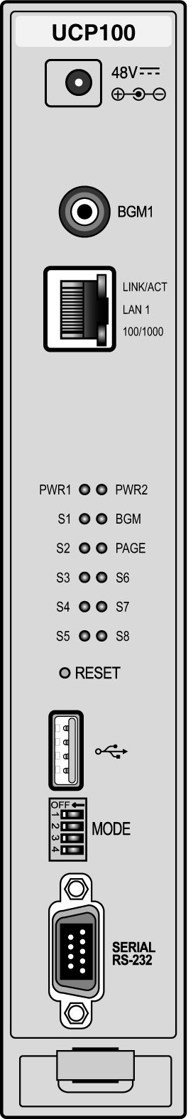

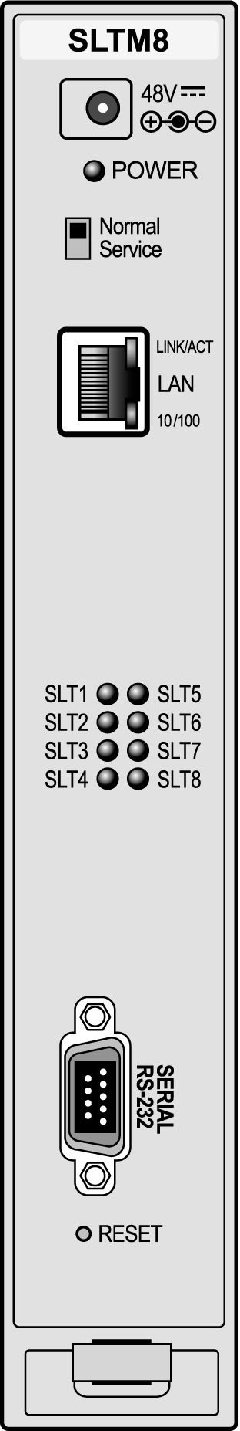

Refreshed UCP100/SLTMs (1/2)
(Unified 5.0)
New UCP100, SLTM4/8/32 with new DuSLIC solution
  Specifications are the same
    Current Intel DuSLIC-xT2 (Discontinued) → New DuSLIC-xs2 (same as eMG100)
  Model names stay the same
UCP100
SLTM4
SLTM8
SLTM32

Slide 19
Refreshed UCP100/SLTMs (2/2)
(Unified 5.0)
Compatibility
  New UCP100 HW compatible with Unified SW V5 or higher
  New SLTM4/8/32 HW can be used with old Unified SW
  New SLTM firmware can be used with old SLTMs
    Old SLTM firmware can’t be used with new SLTMs
> Unified SW compatibility
 | Unified SW 4.1 or earlier | Unified SW 5.0 or later
Current UCP100 HW | Y | Y
New UCP100 HW | N | Y
Current SLTM4/8/32 HW | Y | Y
New SLTM4/8/32 HW | Y | Y
Current SLTMs + New SLTMs HW | Y | Y
> SLTM F/W compatibility
 | Current SLTM F/W | New SLTM F/W
Current SLTM4/8/32 HW | Y | Y
New SLTM4/8/32 HW | N | Y

Slide 20
Unified v4.1 - major features

Slide 21
vUCP Trial Support (1/2)
(Unified V4.1)
Support free vUCP trial for 90 days – need vUCP trial license.
  Applicable features and applications: vUCP call server, all system features and applications to maximum capacity
  Exceptions
    vUCP: vVOIMT/vMCIM
    Applications: CCX (no trial license), CRM for UCS (Need separate trial license for CRM for UCS)
How to get the trial license (refer to “vUCP Trial license download process” for details)
  Partner to download the following base licenses from the license portal and submit to ELG license manager to get the “vUCP-TRIAL” license.
    Base licenses (*.DAT) to download: vUCP-CS2400S, vUCP-SPLD, vUCP-MNTD-TRIAL, vUCP-MNT1
    * MNTD-TRIAL as free trial license indicator to ELG Account Manger so not to be invoiced.
  ELG license manager to provide the “vUCP-TRIAL” license.
    * vUCP-TRIAL license is valid from the date that ELG license manager generates using base license from the partner.
Install vUCP & generate S/N
Generate
base license file (*.DAT with vUCP-MNTD-TRIAL) for trial and send them to ELG license manager
ELG license manager to provide trial license (with vUCP-TRIAL)
Free trial by uploading the vUCP-TRIAL license
Use commercial version
Trial license reset request to ELG
Download the real license
Upload to the vUCP

Slide 22
vUCP Trial Support (2/2)
(Unified V4.1)
Migrate trial version to commercial version before expiration
  Partner to send the trial license reset request (using “reset form” attached) to ELG license manager before expiration
  ELG to reset the trial license.
  Then, Partner can download the commercial licenses using the same serial number.
    vUCP-CS2400S, vUCP-SPLD, vUCP-MNTD, vUCP-MNT1 + required system licenses and application licenses in use (or to use).
  * System goes to the limited mode if no valid commercial licenses after trial expiration.
  ** Trial valid period can be found in the system license overview page.
  *** System to send expiring notice email (one-time notice before 30days and daily notices from 7days before expiration to pre-registered email in system Web-admin)

Slide 23

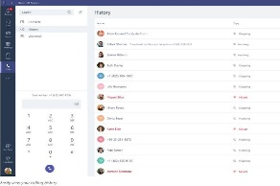
MS Teams Interworking
(Unified V4.1)
Interworking with MS Teams client through Call2Teams M/W
MS Teams Client as a SIP client of UCP/eMG through Call2Teams
  iPECS Phone & Teams Client pairing
  One number / Dual forking
  Basic and supplementary call features
    Internal/external call, Transfer, Hold, Forward, Mute, Conf, Park, Pick-up
    Occasionally, signaling delay from MS Teams may cause various operation delay or failure for supplementary services
    Teams can join as Conf member but Hold not working.
Required licenses
  UCP/eMG
    UCP/eMG-MSTC (MS Teams Connect license, per user) for UCP/eMG as the number of MS Teams users
    SPL license as the number of MS Teams users
  Call2Teams
    Call2Teams subscription (license) per Teams user
  MS Teams license from Microsoft
    Office 365 admin account
    Office 365 E1/E3 subscription + Phone System add-on or E5 subscription per Teams user
PSTN/SIP
3rd Party
SIP Ext.
Call2Teams
M/W (SBC)
iPECS UCP/ vUCP/ eMG
MS Cloud
Teams clients
with Phone System license
ELG terminals

Slide 24
Enhanced features
(Unified V4.1)
Category | Feature | Description
Integration | SMDR - ICM missed call SMDR - Called/Connected Info SMDR - Group call information SMDR - Abandoned call info SMDR Web API - Call ID SIP Paging Device | Support ICM missed call info in SMDR with call duration. Support original dialed info in SMDR for group/pick-up call. Support group call info in SMDR with answered/unanswered. Support abandoned call info in SMDR for disconnected before answer or during CCR announcement Added Call ID in SDMR Web API for call tracking Support DTMF relay during page for 3rd party SIP paging device
UX and Call management | Programmable MOH by station Transfer using DIR search Flexible paging from MEX Transfer to a station in DND/FWD Idle on Hold for CC agent Block transferring a call Ringback tone for group Multi barge-in conference | Support multiple different MOH on flexible buttons so play different MOH to caller when hold/transfer. (Number of VSF MOH is increased to 30) Support a transfer using DIR search Mobile extension can also make a flexible paging from external to system. Support transfer a call to a station in DND/FWD state using “override code”. Add an option “Go to idle on hold” specially contact center agent. Add an option to block a transfer for CO/Internal call Add more ringback tone options for group Enable barge-in conference joined by multiple users up to 32(UCP) 13(eMG)
Security/ Privacy | Web/Telnet enable/disable SMTP password digit increase DSS LED service for specific users | Support enable/disable Web/Telnet connection of phones (1000i only) by system Increased the number of digit to 64 for SMTP password (system / station) Added DSS LED service option to disable for specific stations
Management | Programming in excel style eMG800 time slot full alarm Decimal digit for mini-bar charge License for 3rd party coloring UCP100 SLIU disable option eMG800 ISDN clock sync | Added for SMTP configuration table, LCR tables eMG800 time slot full notification Support decimal digit for mini-bar charge License for 3rd party coloring solution (only for Korea) Added UCP100 disable option to use 2 SPL ports for others Added clock sync for eMG800 slave cabinets

Slide 25
License update

Slide 26
License updates with Unified v4.1
vUCP-Trial license
MS Teams Connector license (MSTC) for each system
CCX Report +
New licenses in Unified 4.1
Licenses
Hardware
Single system software
(Unified SW)
System Port License (SPL)
IP Extension
Apps & Feature licenses
SWA licenses
eMG800
10port
50port
100port
200port
UCP100
10port
50port
UCP600
10port
50port
100port
200port
500port
UCP2400
10port
50port
100port
200port
500port
1,800port
vUCP
10port
50port
100port
200port
500port
2,200port
IPEXT
(ELG
IP/SIP Phones)
3SIPEXT
(3rd party
SIP Phones)
UCP VOIP Switching
vVOIM/vVOIMT channel license
VCIM-DSPCL32 (32ch DSP)
eMG/UCP
MNTD
MNTD2/3/4/5/6
MNT1/2/3/4/5
MNTU1/2/3
Embedded VM ch/memory Exp
UVM channel/memory Exp
vUVM channel license
vMCIM channel license
UCP2400
IPN / TNLS / TNLCM
GR(Geo redundancy)
MEX
Mid
Call Server
G/W &
Accessory
CO/BRI/PRI
SLT/DKTU/
DECT
Voicemail
Conference
Cabinet
Hotel / FIDELIO
3rd PMS I/F (50 Guest room base)
TAPI
3SIPC/3SIPS
MS Lync
MSTC (MS Teams Connector)
AMSI, AMP
API-SMDR*²
API-CTI
API-CTI-EXT
API-AMP
2,400
2,400
eMG800
UCP600
1,200
vUCP
MNTD
vUCP-MNTD-TRIAL
vUCP-TRIAL
> For CS2400
MNTD2/3/4/5/6
MNT1/2/3/4/5
MNTU1/2/3
> For CS2400S
MNT1/2/3/4/5
w/SPL&EXPM
w/SPL
w/SPL
SMB
Virtual
Machine
600
600
600
UCP100
vUCP
w/SPL
199
w/SPL
eMG80
200
w/SPL
100
50
vUCP-CS2400S (SWL)
vUCP-SPLD
50
UCS User lic (Basic/Adv/Power)
UCS Premium Server license
Clickcall*¹
IP Attendant Office / Hotel
IPCR
CCX / CCX R+
NMS
eMG80
eMG800
UCP100
UCP600
UCP2400
vUCP
On-premise
Virtual
On-premise
Virtual
*¹ Clickcall license: Common use for current Clickcall client & new Clickcall Web API (RESTful)
*² API-SMDR: Common use of SMDR RESTful API and SMDR Web API

Slide 27
Web API - Licenses
Web API Licenses for 3rd party applications
Web APIs | Unified 3.5 | Unified 4.0
Click to Call | Click to Call
Call Event |  | Dialing Proceeding Alerting Ringing Connected Released ReleasedAsc Rerouted Rerouting Failed Held Hold | Retrieved Retrieving Transferred Transferring Conferenced Conferencing DoNotDisturb Forwarding Registered UnRegistered MWI | ACD Agent LogOn ACD Agent LogOff ACD Agent Ready ACD Agent Not Ready ACD Agent Work ACD Agent Busy ACD Group Queueing ACD Group Queued ConfGroup Member ConfGroup MuteOn ConfRoom Member ConfRoom Usage SetMuteOn Configuration changed
Presence Event |  | Presence Start Presence Stop | Presence Event
Call Control |  | Make Call Answer Call Clear Connection Reroute Call Hold Call Retrieve Call Consultation Call Transfer Call Single Step Transfer Generate DTMF Reconnect Call | Set Forwarding Get Forwarding Set DND Get DND PickUp Conference Call Call Reject BusyService Set Call Back Get Call Status Call Park Call UnPark | Get MWI Flexible Page ACD Agent LogOn ACD Agent LogOff ACD Agent Set State ACD Group Control Conf Group Call Start Conf Group Call Add Callee Conf Grou0p Call Set Mute On Get Conf Room State Conf Room Open/Close
SMDR | SMDR via HTTPS | SMDR in JSON format via Websocket
ACD Manager |  | ACD Manager Protocol in JSON format
CLICKCALL license(per seat)
API-CTI (server)
Server license for Call Control and Event API
Support 3rd party CTI servers*. API-CTI server license per CTI server including Alarm server for flexible page API and Call event based server for Event API.
In addition, need to add client license (API-CTI-EXT) as the number of clients to use CTI clients for call control.
System base license
This license supports both current AMP and AMP Web API
API-CTI-EXT (per seat)
Client license for Call Control
API-SMDR (per system)
System-base license for SMDR Web API
API-AMP (per system)
System-base license for ACDM Web API

Slide 28
vUCP – License update
New in Unified 5.0
New in Unified 4.0
Added vVOIMT in Unified V4
Single instance vUCP Call Server (w/ built-in vUVM/vVOIM) GW is added in Unified V5
  All licenses can be used for single instance/multi instance vUCP call server and gateways.
2,400 ports
Max SPL 2,400ports with external gateways
600 ports
Max SPL 600ports
vUVM 64ch
vVOM 128ch
Max 248 ch
Max 144 ch
8ch base
increment
Max 64 ch
Default: SPL 50, vUVM 8ch, vVOIM 6ch
8ch base increment
Max 32 ch
CS2400S
CS2400S
Default
SPL 50ports
vUCP Call Server
w/ built-in vUVM/vVOIM Gateway
vUCP Call Server
w/ external gateways
vVOIM
vUVM
vVOIMT *¹
vMCIM *¹
(per Virtual Machine)
(per Virtual Machine)
(per Virtual Machine)
(per Virtual Machine)
*¹ Internet connection is required for online license verification periodically.
Same vUCP call server software (V5) & licenses
If enable built-in vUVM/vVOIM, max system port is up to 600ports.
For more than 600 ports, disable built-in vUVM/vVOIM

Slide 29

vUCP – License update
vUCP gateway licenses for vUCP and UCP
New in Unified 4.0
vUVM
(150ch per vUVM)
vUCP-vUVM-CL8 *¹
vUCP-VMCL8
UCP-vUVM-CL8
vVOIM
(250ch per vVOIM)
vUCP-vVOIM-CL8 *¹
UCP-vVOIM-CL8
vUCP-VOIPCL8
vUCP
UCP
vUCP-vVOIMT-CL32
vVOIMT *²
(32ch per vVOIMT)
vUCP-vMCIM-CL64
vMCIM *²
(64ch per vMCIM)
*¹ vUCP-VMCL8 and vUCP-VOIPCL8 re-named as vUCP-vUVM-CL8 and vUCP-vVOIM-CL8 respectively for naming consistency from Unified 3.5
*² vVOIMT/vMCIM: using software DSP (64ch) → periodic on-line license validation check
- vVOIMT: 2 soft DSP channel per 1 VOIP channel
- vMCIM: 1 soft DSP channel per 1 audio conference channel

Slide 30
Embedded license
vUCP built-in GW is added in Unified V5
 | eMG80 v2.2 | eMG80 v3.0 | eMG800 v2.2 | eMG800 v3.0 | UCP100 V2.2 | UCP100 V3.0 | UCP600 v2.2 | UCP600 v3.0 | UCP2400 v2.2 | UCP2400 v3.0 | vUCP (CS2400) | vUCP (CS2400S) w/ built-in GWs | vUCP (CS2400S) w/o built-in GWs
Built-in VM (Default → Max) | 2ch → 8ch*¹ | 2ch → 8ch*¹ | 4ch → 8ch*¹ | 4ch → 8ch*¹ | 8ch | 8ch | 8ch | 8ch | - | - | - | 8ch → 64 (w/ built-in vUVM G/W) | 8ch → 150 (w/ external vUVM G/W)
Built-in DSP VOIP (Default → Max) | 2ch → 8ch*¹ | 2ch → 8ch*¹ | 4ch → 8ch*¹ | 4ch → 8ch*¹ | 4ch | 4ch | 6ch | 6ch | - | - | -
Built-in VOIP Switching-G.711 only (Default → Max) | - | - | - | - | 0 → 16ch | 0 → 16ch | 0 → 24ch | 0 → 24ch |  |  |  | 6ch → 128 (w/ built-in vVOIM G/W) | 6ch → 250 (w/ external vVOIM G/W)
Phontage (Default) | - | - | - | - | - | - | - | - | - | - | - | - | -
Communicator (Default) | - | - | - | - | - | - | - | - | - | - | - | - | -
UCS Desktop (Default) | 2copy | (2copy)^{*3} | 5copy | (5copy)^{*3} | 2copy | (2copy)^{*3} | 10copy | (10copy)^{*3} | 20copy | (20copy)^{*3} | - | - | -
UCS Mobile (Default) | 2copy | (2copy)^{*3} | 5copy | (5copy)^{*3} | 2copy | (2copy)^{*3} | 10copy | (10copy)^{*3} | 20copy | (20copy)^{*3} | - | - | -
UCS User license (Default) | - | 2copy^{*3} (advanced) | - | 5copy^{*3} (advanced) | - | 2copy^{*3} (advanced) | - | 10copy^{*3} (advanced) | - | 20copy^{*3} (advanced) | 10copy^{*3} (advanced) | 2copy (advanced) | 2copy (advanced)
Clickcall (Default) | 2copy | 2copy | 5copy | 5copy | 2copy | 2copy | 10copy | 10copy | 20copy | 20copy | 10copy | 2copy | 2copy
IPEXT (Default → Max) | 32 | 32 | 30 → 600 | 30 → 600 | 30 → 199 | 30 → 199 | 10 → 600 | 10 → 600 | 10 → 2,400 | 10 → 2,400 | 10 → 2,400 | 30 → 600 | 30 → 2,400
Temporary License Activation | 6 times (1st 60days, 2nd to 6th : 30days each)
*¹ : Built-in VM/VOIP for eMG80/800 : Max 4ch/8ch or 8ch/4ch
*² : Replaced with UCS Desktop/Mobile from v1.2
*³ : Only one type can be enabled by system admin.

Slide 31
SWA Policy Overview
Product | Year 1 | Year 2 +
eMG800 eMG80 P2 eMG100 UCP100 UCP600 UCP2400 | Full Service(60days) - Major S/W Upgrade for 60days from 1st installation + Basic Service (365days) - Minor Software Upgrade Full Service is available by downloading MNTD (optional) till the end of default maintenance period. System controls default maintenance period and MNTD allows only full service during this period. | Optional SWA or On-demand software upgrade licenses MNTD2/3/4/5/6: Optional SWA at initial installation (only one-time use of any one of MNTDx licenses) MNTU1/2/3*¹: On-demand software upgrade licenses after default maintenance or MNTDx/MNTx expiration MNT1/2/3/4/5*²: Renewal licenses before/after MNTDx
vUCP (CS2400) | Full Service - Minor/Major Software Upgrade Must download MNTD (free) within 60days of 1st installation since vUCP is software base product. MNTD controls default maintenance period.
vUCP*³ (CS2400S) | > Year 1 (default) + Year 2 (mandatory) ← Until Q1/2020 Full Service - Minor/Major Software Upgrade Must download MNTD + MNT1 at initial installation .MNTD provides 26 months including one-year mandatory period. .MNT1 ~5 can be also downloadable for additional period.
vUCP*⁴ (CS2400S) | > Year 1 (default) + Year 2 (mandatory) ← After Q1/2020 (Exact date to be announced before applicable around early Q1/2020) Full Service - Minor/Major Software Upgrade Must download MNTD + MNT1 at initial installation .MNTD provides 26 14 months including one-year mandatory period. .MNT1 provides 12 months. .MNT1 ~5 can be also downloadable for additional period. is only available for renewal. (only yearly renewal, not multi-year renewal for license simplification)
> Year 3+
Optional SWA licenses: MNT1/2/3/4/5
3 different prices for MNTx
Regular renewal within grace period
Renewal below 5 years after SWA expiration
Renewal above 5 years after SWA expiration
> Year 3+
Optional SWA licenses: MNT1/2/3/4/5
3 different prices for MNT1
Regular renewal within grace period
Renewal below 5 years after SWA expiration
Renewal above 5 years after SWA expiration
*¹ : MNTUx must be downloaded after the expiration of previous SWA licenses including default maintenance since MNTUx validity starts from the issue date. MNTUx doesn’t add remaining days of previous SWA period.
*² : However, MNTx adds the remaining days so no issue when to download.
*3 : vUCP-CS2400S is replacing the previous CS2400 from Unified 3.5 in Jan/2019.
*4 : Automatic SWA step pricing by port range from the license portal is supported from Q1/2020.

Slide 32
vUCP SWA policy with vUCP-CS2400S
 | On-Premise UCP | vUCP-CS2400 (200p default) | vUCP-CS2400S (50port by default)
SWA policy | Optional (1 ~ 5 years) Renewal optional (1 ~ 5 years) | Optional Renewal optional (1 ~ 5 years) | One-year mandatory Renewal optional (1 ~ 5 years) (yearly renewal with MNT1) - Regular yearly renewal before expiration: same price - Below 5 years after expiration: MNT1 at doubled price (standard MNT1 x 2) - Above 5 years after expiration: 100% of product price(all licenses) + standard MNT1
Pricing | Fixed pricing for each system - UCP100 / 600 / 2400 Multi-year discount | Fixed pricing for all ranges Multi-year discount | Step price for each range (7 steps) - 50 / 51~100 / 101~300 / 301~600 / 601~1,000 / 1,001~1,500 / 1,501~ No multi-year discount
 | 1Y | 2Y | 3Y | 4Y | 5Y | 6Y | 7Y | 8Y | 9Y | 10Y
at initial installation
In warranty
1 year
(mandatory)
3 options for renewal
Before expiration - regular yearly renewals
Standard price
MNT1 at doubled price
Below 5 years after expiration
MNT1 at the price of
100% of product price including MNT1
Above 5 years after expiration

Slide 33
New license file & S/W version compatibility
System S/W Ver. | Old license file (issued by the end of 2018) | New license file (issued from the beginning of 2019)
3.5.11 or lower | Y | Y* * New license file is not compatible with Unified 1.3.9 or lower. There are several cases as below and please take the proper action for each case. For details, refer to “iPECS Unified S/W v1.3.9 or earlier Upgrade Procedure” guide, available from the global partner site. If SW is v1.3.9 or earlier with valid SWA in previous license file format (before license file upload) If SW is v1.3.9 or earlier with SWA expired (before license file upload) If you've already uploaded new license file with valid SWA, System works in limited service mode and "ILLEGAL LICENSE FILE" is shown in Software Maintenance raw & Purchased column of System Overview menu. If you've already uploaded new license file with valid SWA, System is rebooted repeatedly
3.5.12 or higher | N** ** Basically Unified 3.5.12 blocks uploading old license file format (issued by the end of 2018) however, it allows existing old license file in flash memory which was already uploaded in the previous software version. | Y

Slide 35
UCS license policy for upgrade case
Cases | Policy | Remark
Only System S/W upgrade | Continue to user UCS 5.5 with per device license (no action for UCS)
UCS upgrade 5.5 → 6.0 | Need system s/w upgrade to Unified v3.0 under valid SWA Case 1) Full 6.0 features – Need to migrate license via the license portal UCSDS → Basic user UCSDSV → Advanced user UCSDP → Basic user + Premium server UCSDPV → Advanced user + Premium server UCSM → Advanced user Case 2) Only partial 6.0 features – No need any action
New deployment UCS 6.0 | Only per user license
UCS 6.0 → UCS 6.0 user license upgrade | Following cases available. Need to pay the price difference Basic → Advanced user Basic → Power user Advanced → Power user
Current UCS Users
(Before v5.5)
New UCS Users
(v6.0 or after)

Slide 36
Trial / License Transition
Cases | On-Premise UCP/eMG | vUCP
Temp license activation (for trial) | 6 times 1st time: 60days, 2nd to 6th: 30days each | 6 times 1st time: 60days, 2nd to 6th: 30days each
License transition support (only to the same customer) | eMG/UCP H/W replacement: Yes Previous S/N blocking from the license portal Migration to new system : Support by the end of 2017. LIK to UCP MG to eMG800 | H/W Server Change / Re-installation: Yes Previous Software S/N blocking from the license portal Migration to new system : No UCP to vUCP

Slide 37

Temporary license activation
Support “Temporary license activation” up to 6 times
  1st time : 60days, next 5 times : 30days each
  Activation by System Admin - no need to download temporary license from the license portal
  Show Pop-up notice when enabling “Temporary License Activation” about “license upload required before expiration, limited service mode without valid licenses after expiration and recommendation on database download”.
  Daily email notice from 7days before expiration to pre-registered email in Web-admin.
  And also, daily notice to system attendant phone from 7 days prior to expiration (Disabled by default)
Need valid licenses from this
1st time
(60days)
2nd time
(30days)
3rd time
(30days)
4th time
(30days)
5th time
(30days)
6th time
(30days)
If valid licenses at expiration → Normal operation
If license in-valid at expiration → Disable feature or go to “limited service mode”. Refer to below table.
 | eMG80/800/UCP/vUCP | CM
1) System feature license | Disable system feature | Disable system feature except TAPI, LNKGW, GR. *TAPI, LNKGW, GR → Go to “Limited Service Mode”
2) Seat/Copy base license | Disable the whole application or feature with in-valid license | Goes to “Limited Service Mode”
3) SPL/IPEXT/3SIPEXT | Goes to “Limited Service Mode” | Goes to “Limited Service Mode”
Support emergency installation as well as multiple application trials
Simple and Quick to implement via Web-Admin

Slide 38
Cases for going to “Limited Service Mode”
Valid licenses should be uploaded before expiration for the following cases
Temporary license activation expiration for SME/LME products
- For SME, if SPL/IPEXT/3SIPEXT are invalid, system goes to limited service mode.
When other application / feature licenses are invalid, just disable them.
- For LME, if IPEXT/3SIPEXT and seat base licenses are invalid, system goes to limited service mode.
When feature licenses are invalid, just disable them.
Validity Check
Normal Operation
Default maintenance license(MNTD) upload within 60days of initial installation for LME products
- For SME, MNTD is not mandatory to install. It’s necessary to download MNTD when major software
upgrade is necessary during default maintenance period or download any other licenses for the first time.
Yes
LCM system running as a survivable mode for SME/LME
- For SME, needs reconnection to CCM system within 60days
- For LME, needs reconnection to CCM system within 30days
No
Stand-by system running as a redundancy mode for SME
- Needs reconnection to Master system within 60days
Limited Service Mode
(Blocking only normal outgoing calls)
Upload valid licenses
or
2) Delete temp license from the DB
* LCM/Slave system – reconnection to CCM/Master system
Illegal (Intentionally changed) license file upload for SME/LME
* When uploading the license file, system date should not be earlier (past) than license issued date.
Ex) Uploading Jan/2018 issued license to system date Dec/2017 is illegal

Slide 39



Limited Service Mode
System goes to the “Limited service mode” when it reaches license invalidation.
  Internal calls, Incoming calls and emergency outgoing calls are supported
  Outgoing calls are only allowed from the system attendant (to be supported from Unified v3.0)
  Remote PPP Connection is supported
Emergency Calls
Remote PPP Connection
Internal calls
Incoming calls
Outgoing calls from system attendant only
System Attendant
No Outgoing Calls

Slide 40
License portal enhancement for vUCP SWA from Feb 25, 2020

Slide 41
License portal enhancement - overview
vUCP SWA policy stay unchanged. Only license portal is enhanced for simplified vUCP SWA pricing.
  One-year mandatory at initial installation - In-warranty MNTD (14m) + mandatory MNT1 (12m)
  Yearly base renewal - only MNT1 available. Downloadable from 90days prior to expire date for next download
  3 renewal pricing options based on the renewal timing - within grace period (expire date + 30days), within 5years after expire, above 5years after expire
  Step pricing - 7 steps (~50, 51~100, 101~ 300, 301~600, 601~1000, 1001~1500, 1501~2000)
  No pro-rata applied - Pricing step is calculated based on the total SPL ports at the time of license download
License Portal is enhanced to fully support the SWA policy together with fixed step pricing from the dynamic pricing. The updated license portal (vUCP module) is to be open on Feb 25th, 2020. No impact on other license portal operation.
Simply partners need to follow the updated process in the license portal.
  Refer to the details on following slides.

Slide 42
License portal enhancement - vUCP SWA automatic fixed step pricing
Before
  Dynamic pricing was applied: base price + xx% of sum of total SPL prices downloaded.
After
  Fixed step pricing is to applied: apply the fixed price for each range depending on total system ports (default 50 + downloaded SPL ports).
  Now ready to apply 3 renewal pricing options.
Before
After
System port range | Standard pricing (Same for renewal)
50 | Base price
51 ~ 2,400 | Dynamic pricing depending on number of total SPL ports (Base price + xx% of total SPL prices)
System port range | Standard Step pricing | Renewal from 30days after expire date to 5years | Renewal above 5years after expire date
50 | Fixed pricing depending on total number of SPL ports (7 steps) | Standard MNT1 x 2 | All licenses and standard MNT1
51~100
101~300
301~600
601~1,000
1,001~1,500
1,501~2,400
* 50% of each step price is added to MNT1 if GR license is in use.

Slide 43
License portal enhancement – updated flow/condition
> Updated flow/conditions in license portal for vUCP
vUCP-CS2400S (SWL)
vUCP-MNTD (14m+12m = 26 months)
vUCP-SPLD
Port and feature licenses (optional)
Generate/ Download license file
Before
Feb 24, 2020
vUCP-CS2400S (SWL)
vUCP-MNTD (14 months)
vUCP-SPLD
Port and feature licenses (optional)
vUCP-MNT1
(12 months)
Generate/ Download license file
After
Feb 25, 2020
Before | After | Remark
MNTDx/MNTx can be ordered | Only MNT1 can be ordered | MNT1 : 1year maintenance lic. (variable amount)
License file can be generated/ downloaded without MNTDx/MNTx | MNT1 license must be ordered for generating/downloading license files | “download” button will not be displayed if MNT1 is not ordered
MNTDx/MNTx prices were independent of installed SPL quantities | MNT1 price will depend on installed SPL quantities (7 steps) | If any inquiries on MNT1 pricing, send them to account managers.
MNTDx/MNTx can be ordered at any time | MNT1 can be ordered only after “90days before expire date” (Except for 1st MNT1 order) | 1st MNT1 order must be made at initial license order.
No additional charges for ordering after expire date | MNT1 price will be doubled if ordered 30days after expire date | Different rule will be applied for ordering 5-years after expire date
No additional charges for ordering after expire date | Total price of all installed licenses will be added to MNT1 price if ordered 5years after expire date

