Slide 1
iPECS SBG-1000 Introduction
Smart Office in a Single Platform
KS Choi
ES) PLM Team
Oct. 2011(Ver 1.1)

Slide 2
Index
Introducing SBG-1000
Service capability
Value propositions
Possible business models
SBG-1000 Overview by category
Positioning
Competitive advantages

Slide 3
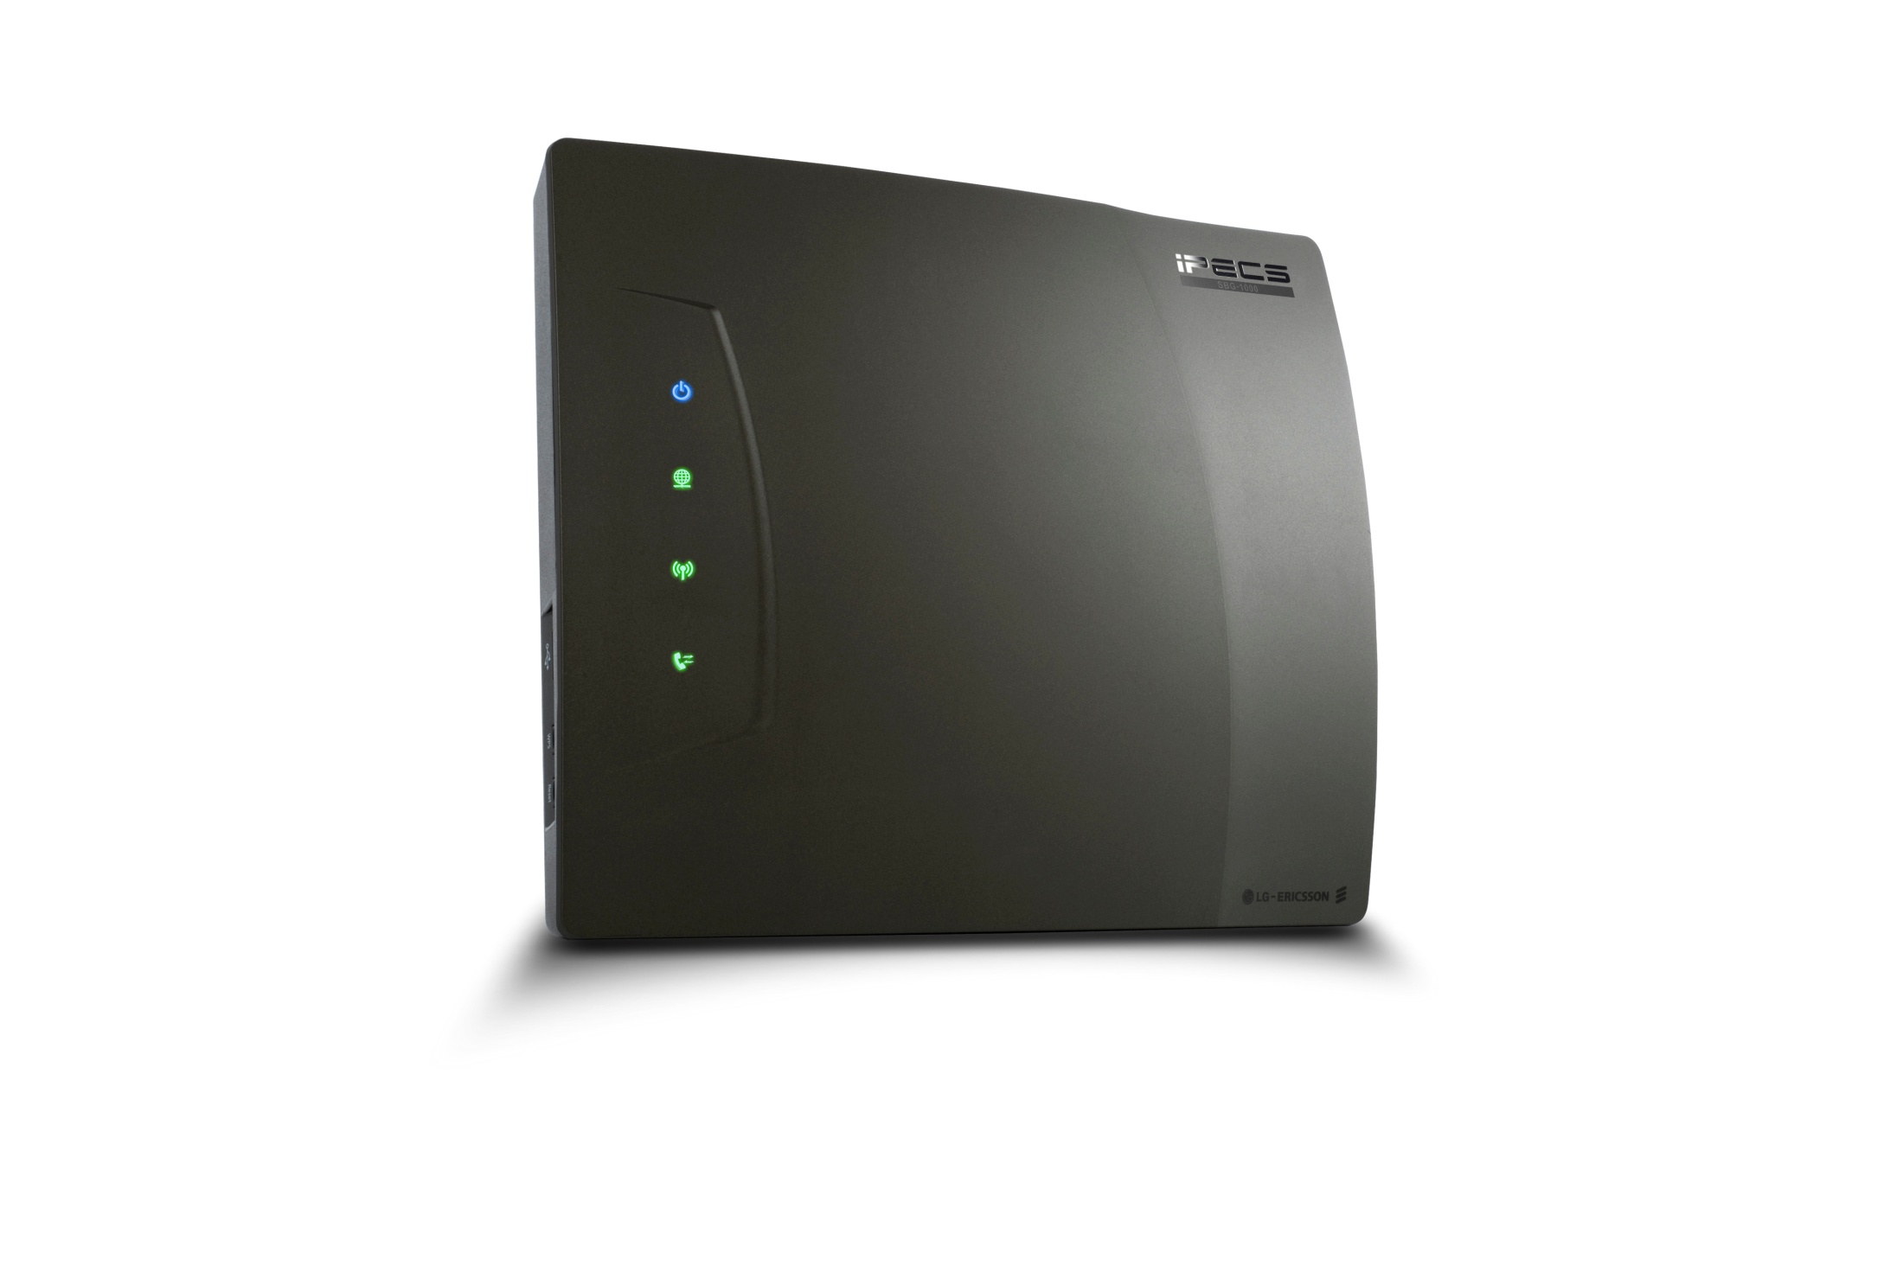

Introducing SBG-1000(Smart Business Gateway)
Smart Office in a single platform - converged communication platform for small businesses
Designed to support IP hosted and managed service models - Platform as carrier’s next generation multiple communication services
VOICE
Carrier’s
managed
IP Network
DATA
SECURITY
IT Services

Slide 4
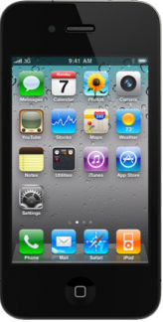






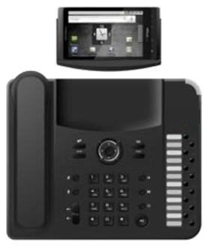

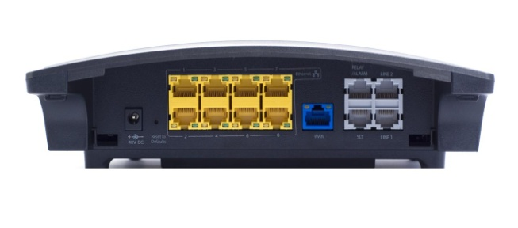

Introducing SBG-1000
Smart, Simple, Secure and Mobile as key concept
Environment-Friendly from product, design to packaging
  RoHS, REACH, EEE-ready WAN
3G/4G
(Phase 2)
Wi-Fi
3G/4G
11n MIMO Wi-Fi
DECT
Remote
Management
Carrier’s
managed
IP Network
Reliable DECT
6 SIP trunks +
1CO, 2CO, 4CO, 1BRI or 2BRI Option
Docking station
24 Users
(23 IP + 1 FXS)
IP Phones & PCs
Smart Phone/Laptop
with VoIP clients
IT facilities

Slide 5
Values to customers
Smart Office in a box
  Optimum flexibility for wired, wireless or combined deployments
  Greater mobility for anywhere connectivity anytime
  Valued communication services available to small businesses within limited resources and budgets
  Single platform from single provider for every communication needs
Voice
IP-PBX & SIP
DECT for reliable voice
Multiple choice of terminals
VM & Applications
Data
Routing
Switching
Enhanced QoS
WLAN for Voice & Data
Security
VPN (IPSec, PPTP, L2TP)
Firewall
Access Control, DMZ
Rule-based packet filtering
IT Services
File server
Print server
Fax / PoS connect
Relay for Door open/Alarm

Slide 6
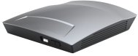
Values for Carriers
Platform as a multiple communication services
  Perfect fit for IP managed services for new revenue stream
  Designed for standalone, multi-site or brand offices
  Proven compatibility with major softswitches like Broadsoft R.17
  Simplifies network management and administration
SIP Trunk
Softswitch
Managed VOIP Service
Cable
High-speed internet
Remote
Management
xDSL
Managed Data Service
Fiber
(10/100M or 1G)
Remote Support

Slide 7
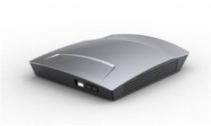
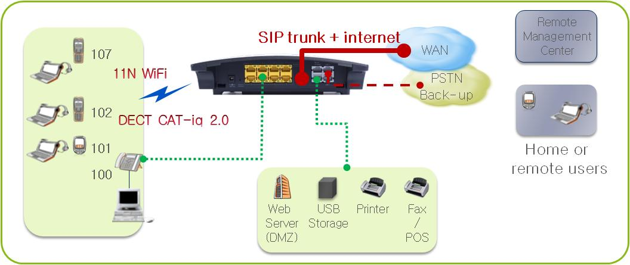
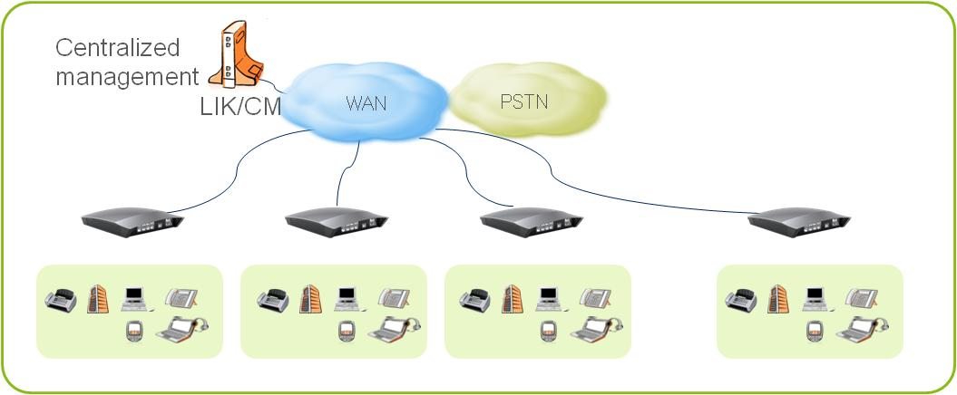
Business models with SBG-1000
Service Providers and General distribution models depending on the SIP availability
Service Providers
IP-Centrex
IP Managed Services
VoIP providers
1
Carrier
IP Network
(WAN)
Softswitch
SBG-1000
w/ Integrated IP-PBX
Remote
Maintenance
Center
SBG-1000
w/ SIP Proxy
General distribution
Standalone businesses
Multi-site businesses
Branch offices
2

Slide 8

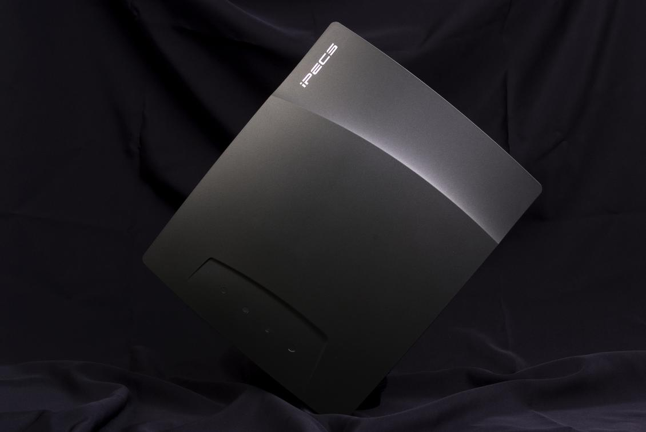
SBG-1000 Design
Green & Eco-friendly design
  Energy Efficiency on WAN
    802.3az compliant
  ECO friendly design & packing box
  Fully compatible with environmental regulation
  : RoHS, PFOS, Reach

Slide 9
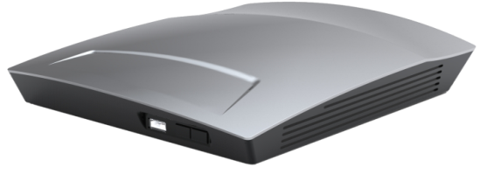
SBG-1000 Hardware interfaces
Design & Hardware Interfaces
  Simple & premium look
  Wall mounting or desktop installation
Trunks
- W/DECT : 4 SIP trunks + 1, 2, 4 CO or 1, 2 BRI
- W/O DECT : 6 SIP trunks + 1, 2, 4 CO or 1, 2 BRI
24 Extensions (23 IP phones + 1 FXS)
DECT
11n MIMO WiFi (2.4G)
PoE
Power Jack
(48V/0.8A)
WAN port
(Gigabit)
Relay/
Alarm Sensor
USB
LAN port(10/100M)
4 standard + 4 PoE
FXO/FXS
(1~2port)
WPS Button

Slide 10
SBG-1000 Function blocks
Function Blocks
  All telephony, data networking, security & wireless functions are available from a box
  Easy to install and use from a Smart Install Wizard & single management Web interface
LG-Ericsson IP-PBX (LIK)
Max SIP Trunk (4 w/DECT, 6 w/o DECT)
Failover to PSTN
(1, 2, 4 CO or 1, 2 BRI back-up)
Max Extension : 24 extensions
Static Routing, RIP v1/v2
8-port (4 standard+4 PoE) 10/100M
STP/RSTP, VLAN
IGMP Snooping v1/2/3
IP-PBX / SIP
Routing/Switching
Wide range of desktop IP phones
DECT desktop & terminals
IP Softphones
Smart phone clients
Plug & Play installation with Wizard
/
Unified management for all elements
General QoS Profile
Traffic Priority & Traffic Shaping
DSCP / 802.1p
Priority Queue Configuration
Terminals
QoS
Built-in Voice mail (4ch/480min)
IP Softphones
Call Recording
802.11 b/g/n 2.4GHz 2x2 MIMO
Multiple SSIDs
WPA/WPA2/WEP, WMM QoS
Wireless Protected Set-up
Applications
WLAN
Built-in file server
Built-in print server
Firewall (SPI) / DMZ Host
NAT/NAPT
Virtual Private Network (IPSec, PPTP, L2TP)
Rule-based Packet Filtering
IT Facility Service
Firewall/Security

Slide 11
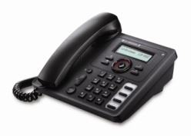




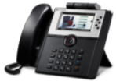
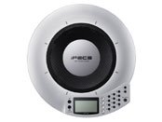
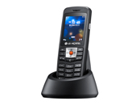
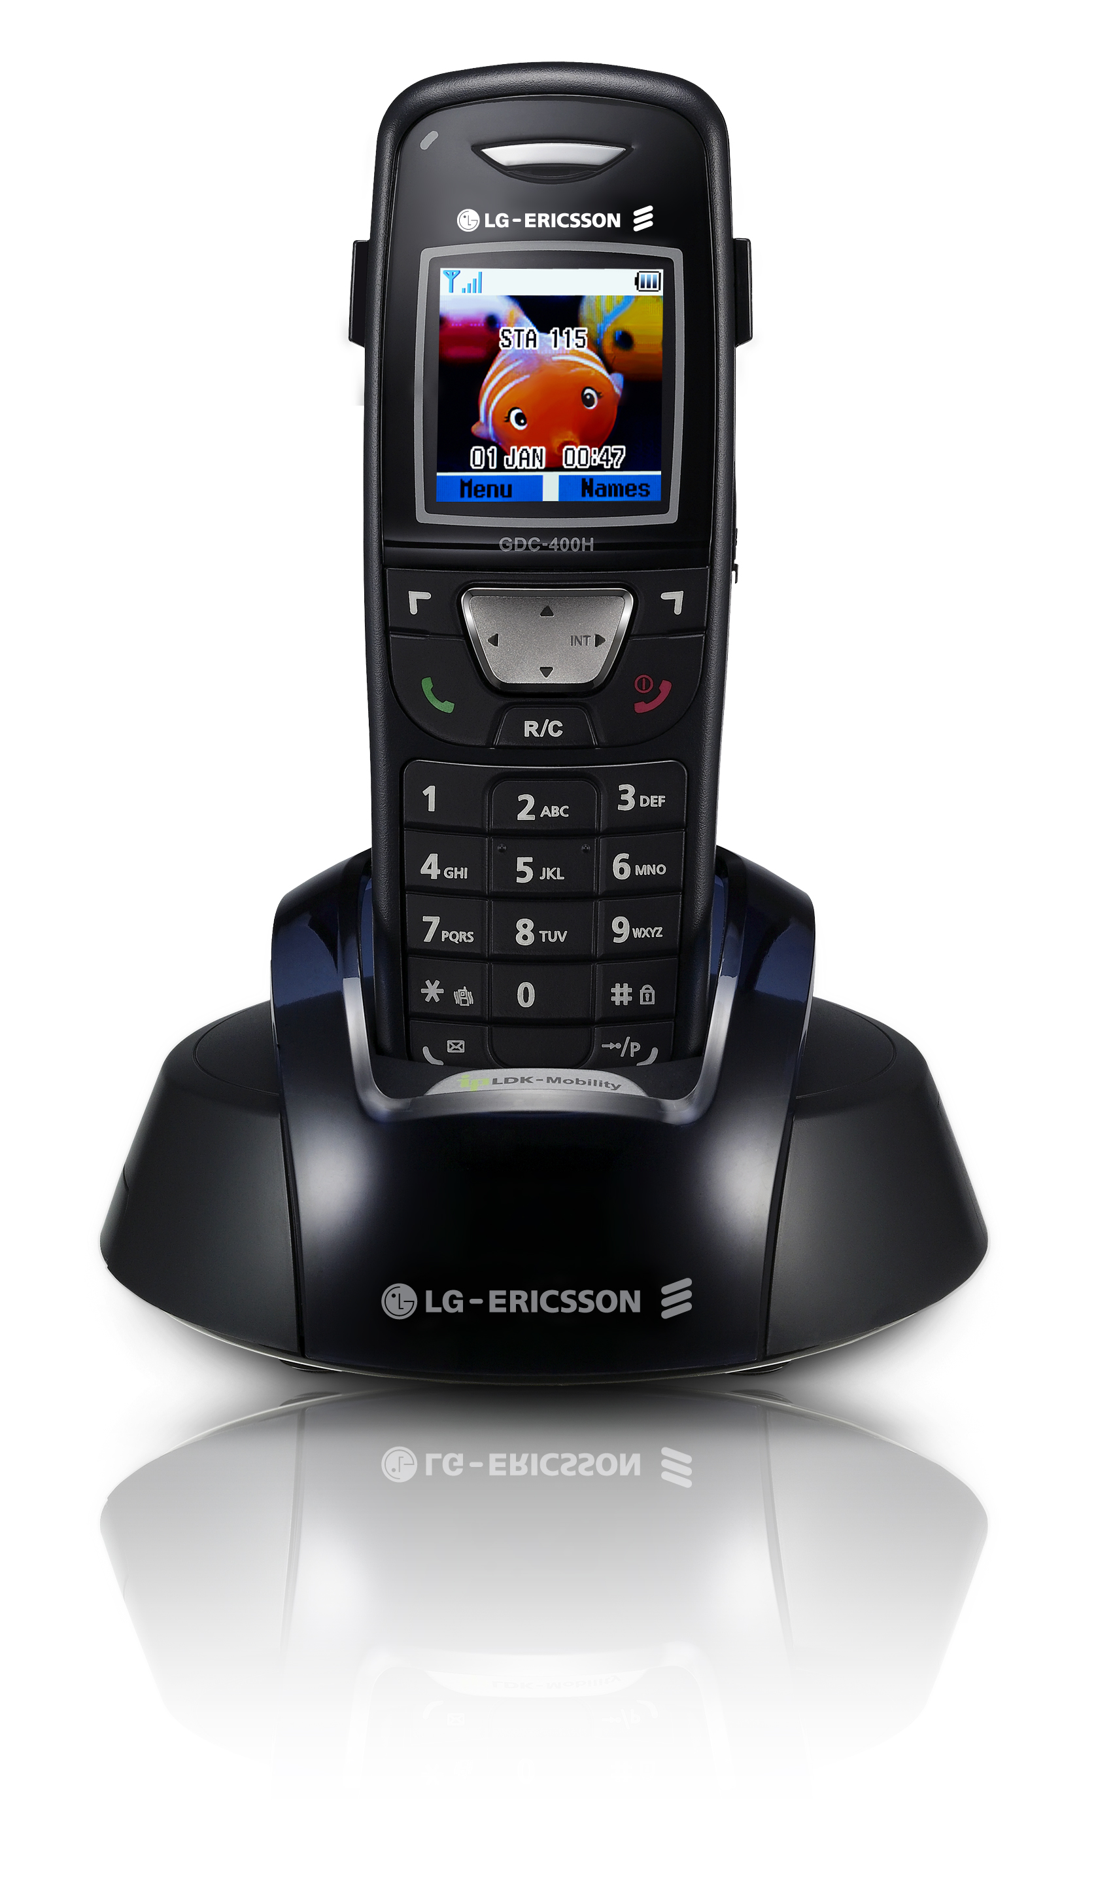
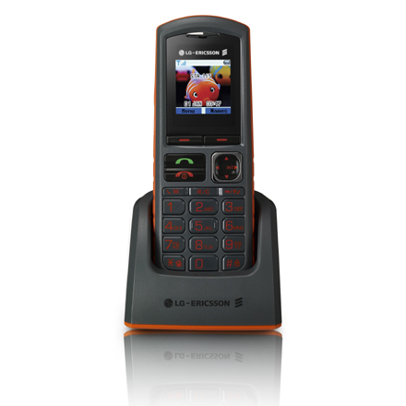
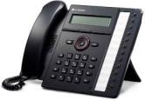
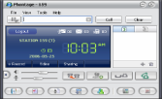
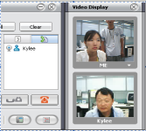
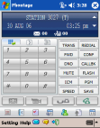
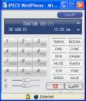


SBG-1000 Terminals & applications
Wide range of terminals and applications
IP
Terminals
Entry
LIP-8002E
Compact
LIP-8008D
Standard
LIP-8012D
Professional
LIP-8024D
Executive
LIP-8040L
Premium
LIP-8050V
Conference
ACT-50
Wireless
Wi-Fi
DECT
WIT-400H
LWS-WK
GDC-400H
GDC-450H
Soft clients*
Phontage
(LIP-SP)
Phontage
Deluxe(LIP-SPD)
Phontage
PDA(LIP-SP)
Web Phone
(LIP-WP)
Applications
/
System
License*
IPCR
(IPCRS/IPCRC)
Ez Attendant
(SBG-1K-EZA)
IP Networking
(SBG-1K-IPN)
TAPI
(SBG-1K-TAPI)
3rd party SIP phone
(SBG-1K-SIPE)
* Dedicated licenses are needed for soft clients and applications respectively

Slide 12
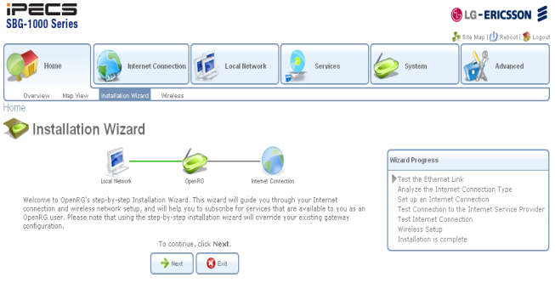
SBG-1000 Easy installation
Plug & Play like Installations & Configurations
  Smart Install Wizard with pre-defined configurations for quick & simple voice and data installations
  Auto discovery and registration of LG-Ericsson IP phones, DECT desktop phone and DECT terminal
  Easy-to-connect for Wi-Fi devices via WPS (Wi-Fi Protected Set-up)
Smart Install Wizard

Slide 13
SBG-1000 Easy Management
Easy and cost effective management
  Installation & Management
    Installation Wizard
    Intuitive single Web-based Management
    Support SNMP, TR-069, CLI (Telnet / Telnet over SSL)
  Maintenance & Troubleshooting
    Device Configuration Up/download & F/W Upgrade
    Network Connection Management, Monitoring & Diagnostics
    System Log / Security Log & E-Mail Notification / Syslog Support
Carrier
IP Network
(WAN)
ADSL2/2+
Remote
Maintenance
Center
VDSL2
Fiber
(10/100M or 1G)

Slide 14
SBG-1000 Voice services
Full feature IP-PBX
  Call Forward, Call Park, Call Pick-Up (Direct/Group), Call Transfer (Station/CO/Voice Mail)
  Call Waiting/Camp-On, Dial-by-Name, Do Not Disturb, Hold/Recall, DSS/BLF, Intercom
  CO Queuing, Delayed CO Ring, CO Line Preset Forward, CO Ring Assignment
  Speed Dial (Individual/Common), Last Number Redial, Message Wait/Call Back
  Station Groups (Circular / Terminal / Ring / Pick-Up / Voice Mail), Flexible Numbering Plan
  Built-In Auto Attendant & Voice Mail, Answering Machine Emulation
  On demand call recording - Voice call recorded in system voice mail storage
  Mobile Extension, Three-Party Voice Conference, IP Fax Relay (T.38)
Advanced Applications
  IP Softphone
  Advanced Call Recording (IPCR)
  SIP client for Smart phone (TBD)
  3rd party application interface via TAPI, SMDR etc.
Standard SIP trunk and extension
  6 SIP Trunk Support
  SIP Proxy / Registrar / User Agent
  SIP Extension Support

Slide 15


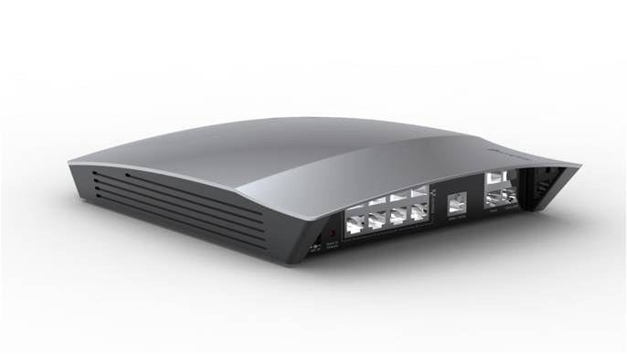




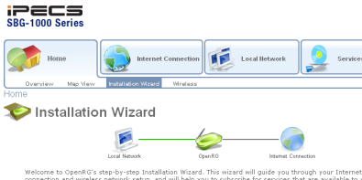

SBG-1000 Mobility
Smart Mobile Office in a simple and secure way
  Providing complete wireless solution for in-premise & external mobility for voice and data services
  Minimal wiring & configurations with pre-defined Quick Install Wizard
  Multiple choices of wireless voice mobility
    DECT Desktop Keyset for same rich feature experience as desktop phone
    DECT and Wi-Fi phones
    IP Softphone, SIP Clients for Smart phones
  One number for system IP phone & softphone (LG-Ericsson Proprietary)
  Simultaneous Ringing (Sim-Ring) for multiple devices
SIP Client
on Smart phone
WiFi Laptop
11n
Ext 100
Carrier
IP Network
Softphone
WiFi phone
DECT
SIP Client
on Smart phone
Ext 100
DECT phone
DECT Desktop

Slide 16
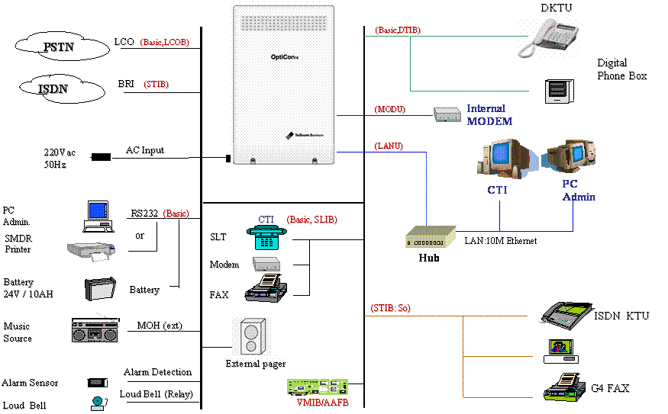
SBG-1000 Built-in IT service interfaces
Built-in services for connecting IT facilities in a cost effective way
  Providing major interfaces connecting comprehensive IT facilities for small offices in a simple and cost effective way
  Built-in file server and printer server
    File Server
      Provide a file server utility, allowing to perform various tasks on files, such as manage file server, share and define access control list.
      All disk partitions are automatically shared by default.
    Printer Server
      Support for several print protocols, which enable to connect Windows, Unix and Mac hosts to the network printer.
      Ability to define printer access permissions for specific LAN users.
      LPD / IPP / Microsoft Shared Printing Support
DMZ
USB Hub
FXS
Alarm
Sensor
Relay
Storage
Printer
Web-Server
Fax

Slide 17
SBG-1000 Data networking services
Comprehensive data networking services in a single box
Firewall
General Security Policy, Access Control, Web Site Restriction
Port Forwarding, Port Triggering, NAT/NAPT, DMZ Host
Rule-based Packet Filtering, Connection Information, Security Log
Security
Virtual Private Network (IPSec, PPTP, L2TP)
Remote Administration Access Control
Digital Certificate Management
QoS
General QoS Profile, Bandwidth Restriction
Rule-based Traffic Priority & Traffic Shaping
DSCP / 802.1p / Priority Queue Configuration, Connection Utilization & Statistics
Routing
Static routing (Routing Table Management)
Dynamic routing (RIP v1/v2)
NAT/NAPT, IGMP/Multicast
Switching
8 Port 10/100 Base TX with 4 Built-in PoE (20 Watts PoE Budget)
STP/RSTP, VLAN
LAN Bridge Configuration
Wireless LAN
802.11 b/g/n with WPA, WPA2, 802.1X WEP, Non-802.1X WEP & Web Authentication
Multiple SSIDs (Virtural APs), MAC Filtering, WPS Support
802.11 Mode, Channel Width & Frequency Selection
Services
File Server (Disk Management, Backup & Restore)
Print Server (LPD, IPP, Microsoft Shared Printing Support)
DHCP/DNS Server, Dynamic DNS, UPnP
Administration
Web-based Administration (HTTP/HTTPS), CLI (Telnet & Telnet over SSL)
User Management (Role & Permissions), Date & Time (NTP/TOD with Daylight Saving Option)
Installation Wizard

Slide 18
SBG-1000 Voice services
Comprehensive voice services in a single box
IP-PBX & SIP
LG-Ericsson full feature IP-PBX (fully interoperable with consistent user experience)
6 SIP trunks plus 1 or 2 PSTN back-up trunk
23 extensions (any combination of IP phones, Softphones, Wi-Fi, DECT)
Built-in SIP Proxy, Registrar, User Agent, Failover to PSTN
DECT
Built-in DECT Base Station, Wideband codec
3 Simultaneous calls with 6 registered users
LG-Ericsson feature-rich DECT phones
IP Endpoints
Range of full feature system IP phones from Entry to Executive
IP Softphones and SIP client for Smart phones
Standard SIP phones (Need IOT)
Auto Attendant/
Voice Mail
Well-organized & Easy to set-up Auto attendant & Voice Mail
4 simultaneous channels / 480-minute built-in storage
Voice Mail back-up & Easy management
IP Softphones
(Phontage)
High Voice Quality GIPs Engine, Multiple Codec (G.711 & G.729)
IP Bridge, Outlook Scheduler Sync, DB Import/Export, Phone Book/Call Log MGM’T
Video Conferencing, Instant Messaging , LDAP Search, Audio Tuning Wizard
Call Recording
Voice packet encryption & call recording
Agent Monitoring / Remote maintenance & automatic alarming
Web based GUI, Statistics, User base access level management
Management
Device Information & Map View
SNMP, TR-069
Network Connection Management, Monitoring & Diagnostics
E-Mail Notification & Syslog Support, System Log

Slide 19
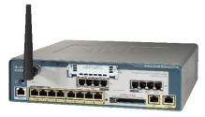
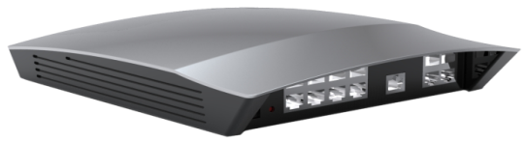
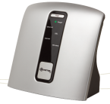
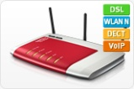
SBG-1000 Positioning
Positioning
Perfect solution for small businesses up to 24 users
  - Standard package up to 12 users
  - Full package up to 24 users
6 SIP simultaneous calls
*Max 2 CO back-up
24 extensions (23 IP)
104 IP extensions
12 FXO or 6 BRI
C
50 user
3 simultaneous calls
20 SIP accounts
20 user
upgradable
SBG
(24
users)
2VoIP+2FXO
4 wired+4DECT
(* extensions)
10 user
SBG
(12
users)
M
A
4 user

Slide 20
Competitive advantages
Competitive advantages
- Feature sophistications in voice and data,
- Wide range of terminals and multiple value added applications.
Vendor
AVM
Mitel
Cisco
LG-Ericsson
Model
Fritz 7270
1000
UC500
SBG-1000
Target segment
WAN
under 5 users
under 5 users
upto 50 users
upto 20 users
LAN
ADSL2/2+
ADSL2/2+,10/100M WAN
ADSL2/2+,10/100M WAN
10/100/1000M WAN
PoE
10/100 4ports
10/100 4ports
10/100M 8ports
10/100M 8ports
Wileless
No
No
Yes (option)
Yes (built-in 4ports)
Physical Interface
USB
802.11b/g/n
11b/g
802.11 b/g/n
802.11n b/g/n
FXO / FXS
2.0 1port
2.0 1port
DECT
1 / 2 + 1 So
2 / 1
Multiple configuration
1 / 2 or 2 / 1
Relay for Door open
Yes (3 simul calls, 6 phones)
Yes (4 phones)
Yes (option)
Yes (3 simul calls, 6 terminals)
IP-PBX
No
Yes
Yes
Yes
Full feature or SIP based PBX
SIP trunk
Number of SIP trunk
SIP
SIP
Full featured IP-PBX
Full featured IP-PBX
Analog trunk
Unmber of CO trunk
3ch
2ch
6 trunks (4 with DECT)
Extension
Number & type of extensions
SIP 20 accounts
2CO
Multiple configuration
4 CO or 2 BRI max
Network control
IGMP/VLAN/STP/QoS
?
8 extensions
50 extensions
23 extensions
WLAN RF
11 b/g/n
Yes
Yes
Yes
WLAN
Multiple SSID
Yes
11 b/g
11 b/g/n
11 b/g/n
WPA/WPA2/WMM/WPS
Yes
?
Yes
Yes
User service/control
DHCP
server, client
WPA
Yes
Yes
Management
NTP / FTP / TFTP
No
Server
server, client
server, client
static routing
No
Yes
Yes
Yes
Routing
RIP
No
?
Yes
Yes
Web based / Telnet
Yes
?
Yes
Yes
Remote Access
SNMP/TR-069
No
?
Yes
Yes
NAT/Firewall/DMZ
Yes
Yes
Yes
Yes
Security
VPN
Yes
No
Yes
Yes
File/Print Server
Yes
No
Yes
Yes
Voicemail
No
Yes (2ch, 30min)
No
Yes
Application
Softphone
No
No
Yes
Yes (4ch, 200min)
Attendant / IP recording
No
No
Yes
Yes
Digital phonles
No
Yes (4)
Yes
Yes
IP Phones
?
No
No
No
IP Terminals
DECT
Yes
Yes (4)
Yes
Yes
WiFi (system WiFi)
No
No
Yes
Yes
Analog
Yes
Yes
Yes
Yes
Simple/easy configuration
Wizard
Web & Wizard
No
Yes
Yes
Yes
Web & Wizard

