Slide 1
iPECS IPCR 3.0 Introduction
December, 2018
PLM & Planning

Slide 2
IPCR P3.0
IPCR 3.0 introduced to better serve changing market requirements
Market & Requirements
IPCR P2.0
IPCR P3.0
Compliances &
Regulations
Old Engine
New Engine
Old web design
Modern web design
Mid Market
No Redundancy
High Availability*
No DB encryption
Recording/DB encryption
Future Proof
Max 100 concurrent
Max 500 concurrent
*High Availability to be supported in Q1, 2019

Slide 3
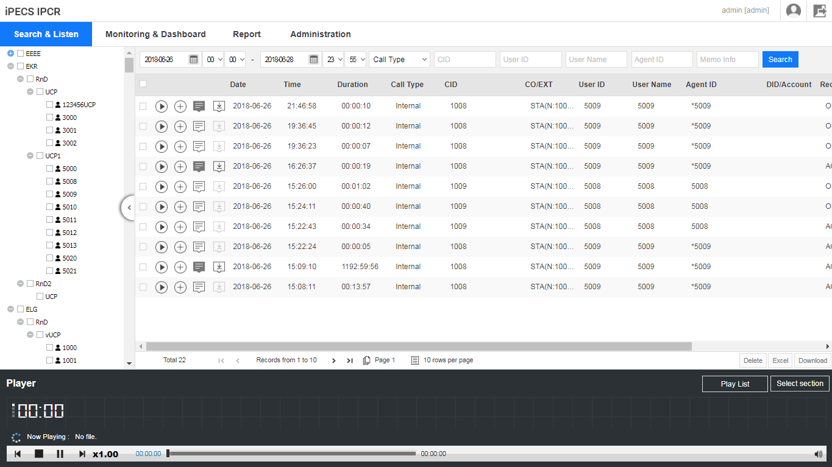
New UI and Feature Improvement
IPCR 2.0
IPCR 3.0
Item | IPCR 2.0 | IPCR 3.0
Capacity | 100 | 500
Browser | IE | Chrome, Opera, Edge, Firefox, etc.
Encryption | AES-128 | AES-128
Search | Basic | Advanced playback options
Report | 4 type(Month, Day, Hour, Agent) | 6 type(Month, Day, Hour, Agent, CO, DID)
Dashboard | Resource | Resource + Performance
Redundancy | Not supported | UCP/UCM* Geo redundancy compliant Local High Availability*
* IPCR only supports call server(UCP/UCM) geo-redundancy.
** UCM/UCP and HA to be supported in Q1, 2019

Slide 4
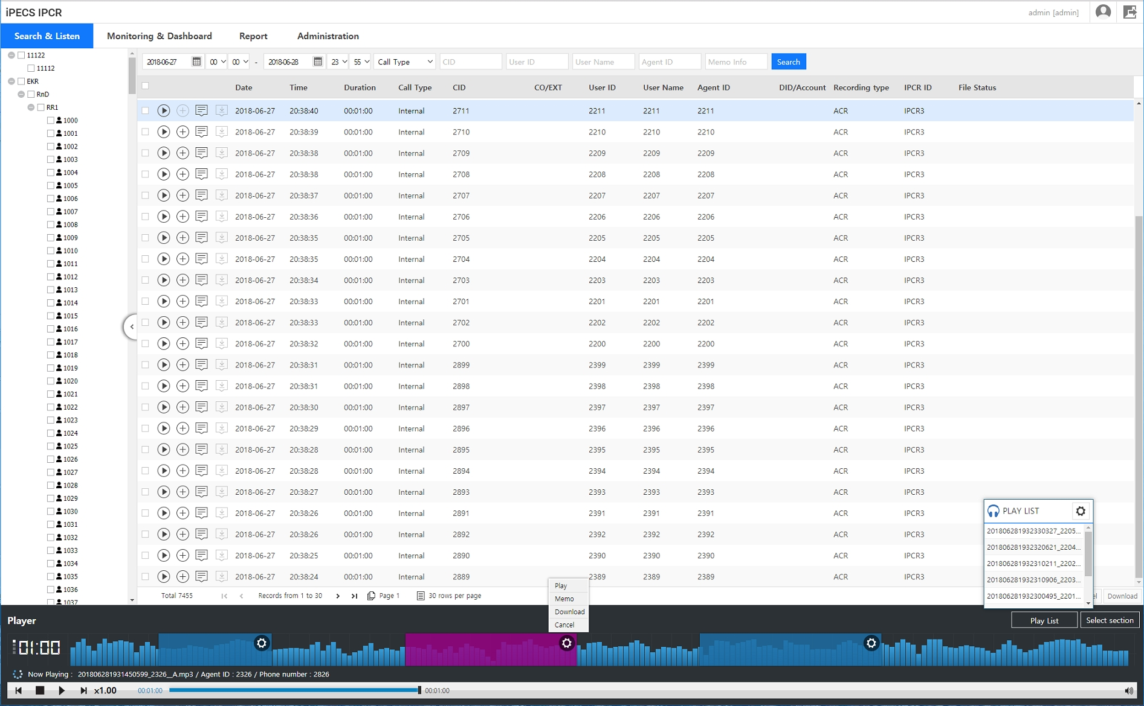
Search & Play
Intuitive UI
Various Filtering options
Easy Icon access
Organization folder
Advanced Playback options
Playlist (max 20)
Section (max 5)
Play, Memo, download
Play speed
x0.25 ~ x2.5

Slide 5
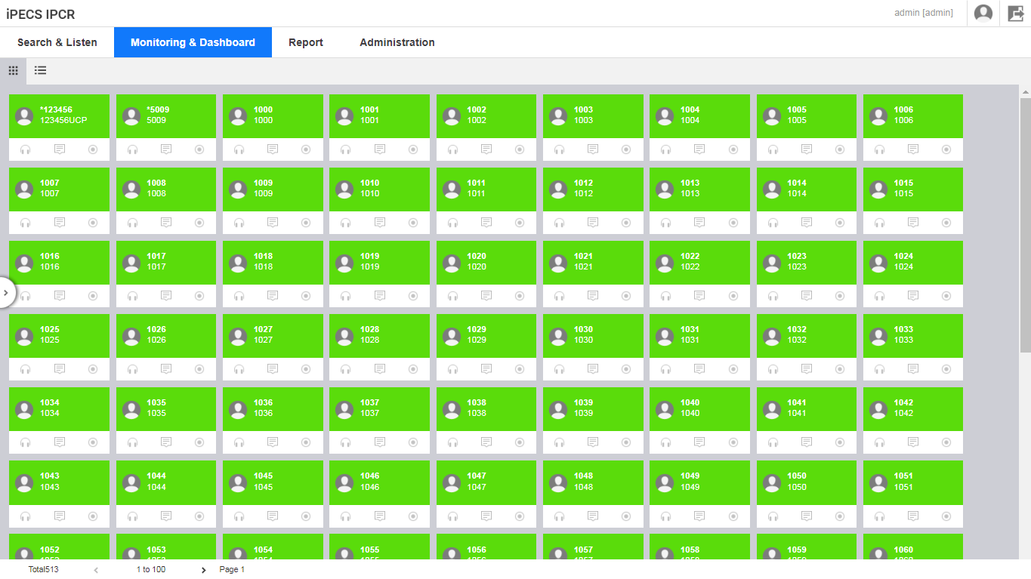



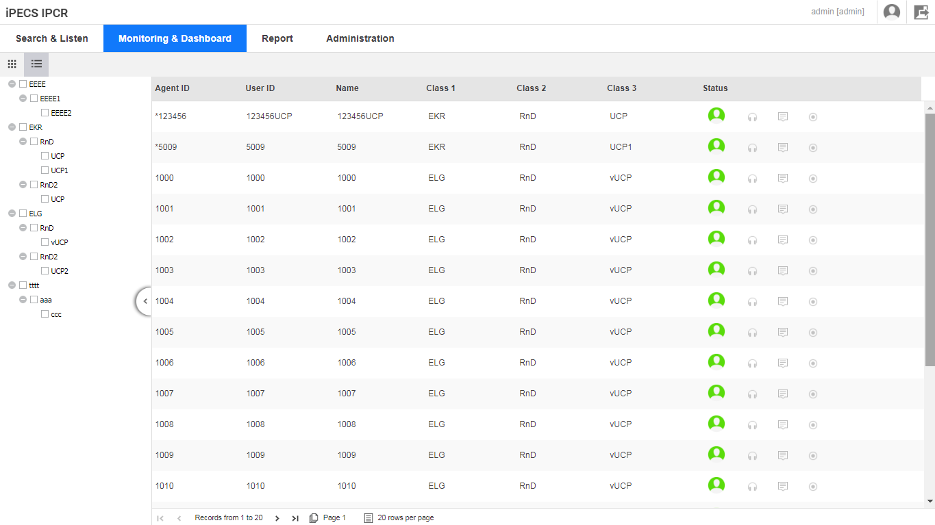








Monitoring
Monitoring with 2 display options
Card type
List type
Max 100 agent display per page
Color and Icon based status monitor
Log-in
Busy(ODR)
Log-out
disable
enabled
active
Monitoring
Record
Memo

Slide 6
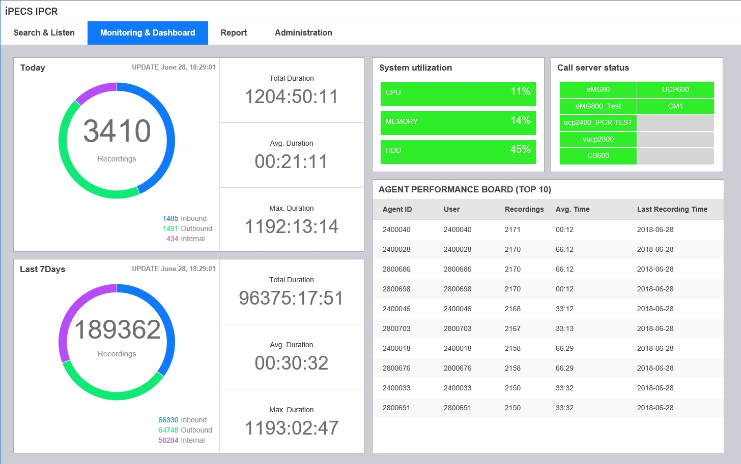
Dashboard
Comprehensive dashboard
IPCR Performance
Today, 7 day statistics
Type by colors
Total/Avg/Max
Resource status
CPU, Memory, HDD %
Threshold by colors
System status
Max 10 PBX link status
Agent Performance board

Slide 7
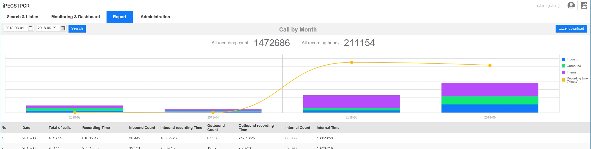
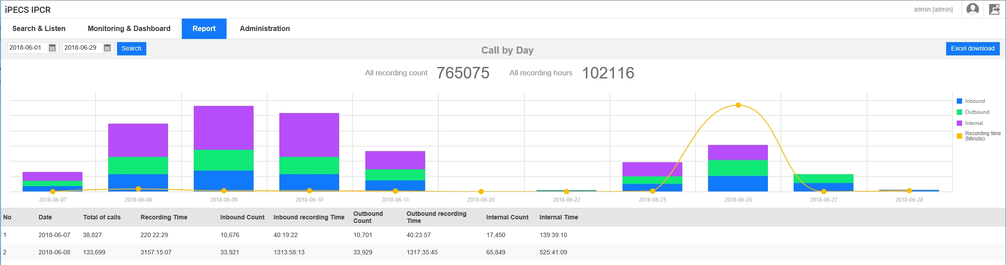
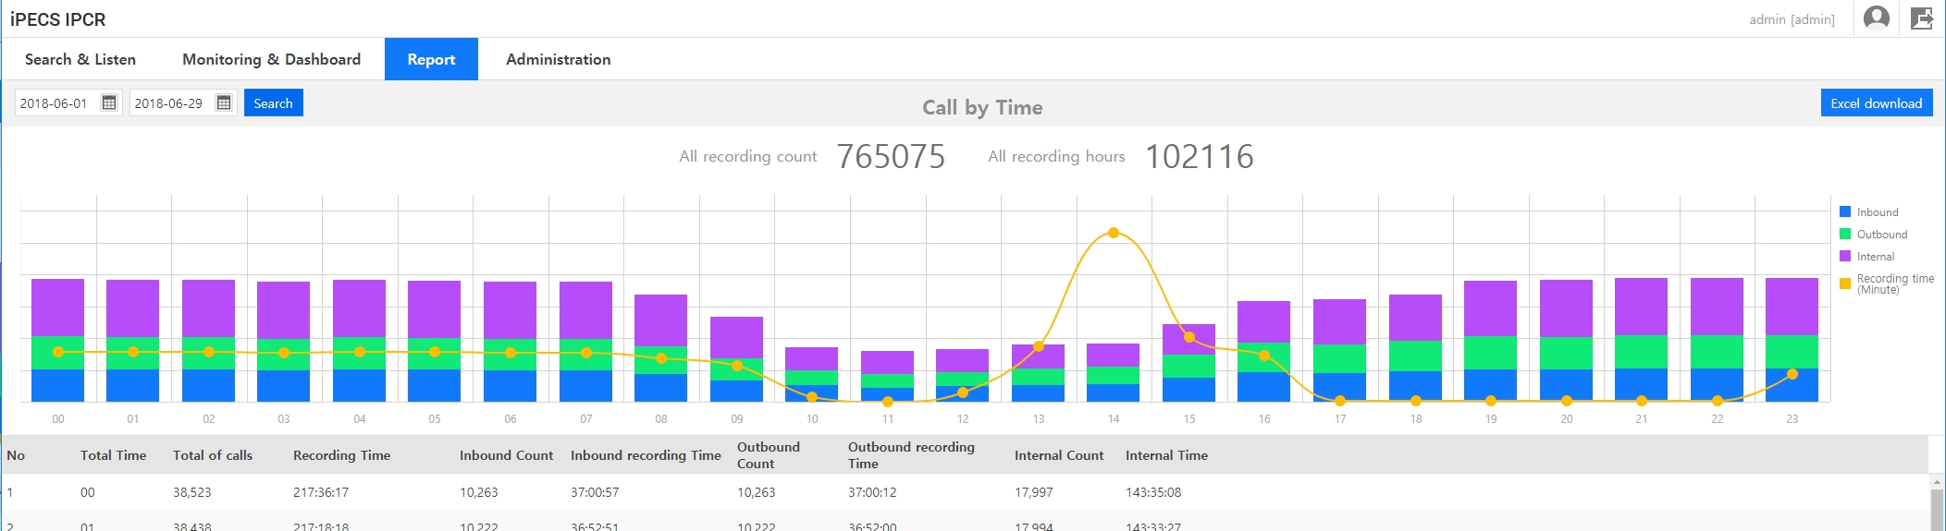
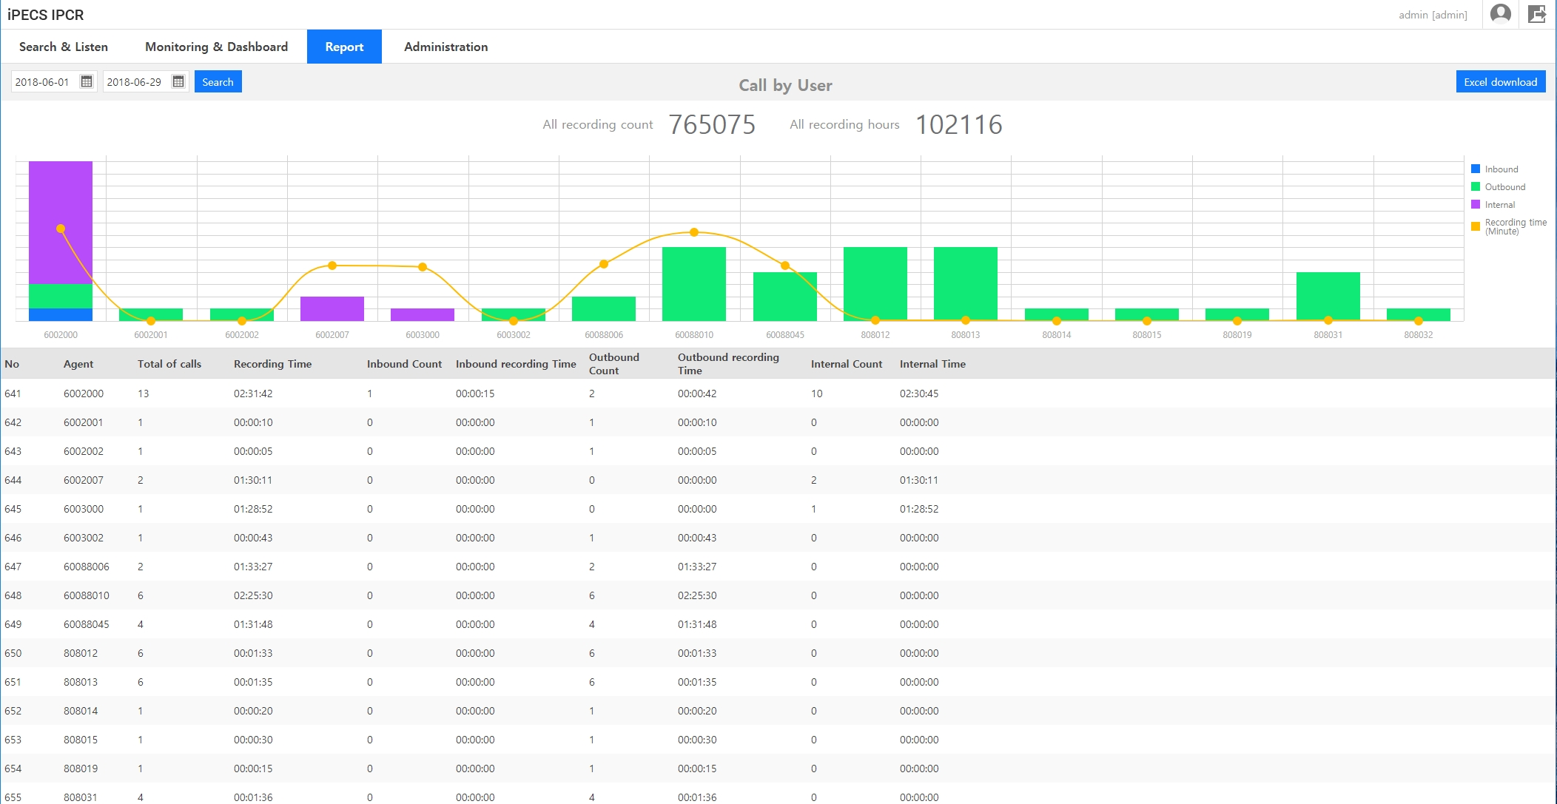
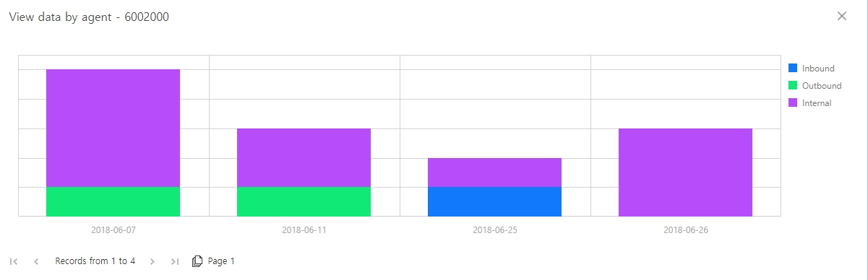
Report
UI improvement
Total Recordings/Time
Recording type by colors
Direct Access to
6 pre-defined reports
Month, Day, Hour
Agent
CO, DID
Download(excel)
Drill-down feature
Agent Report only

Slide 8
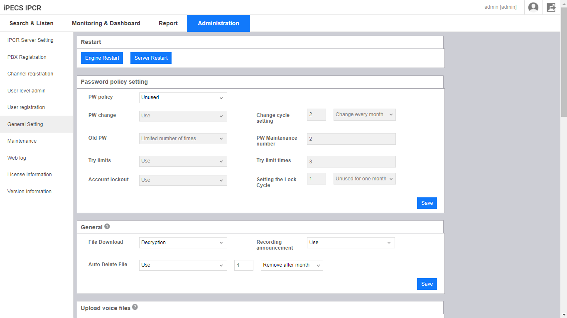
Setting
Organized and Logical Access
Server
PBX
Channel | Server, PBX, Station, Type
Access | Admin, Supervisor, Station
User | Name, ID, station#, access,..
General | Engine, Password, Prompt, Update, Mail server, Fault, Backup, FTP Time
Log
License

Slide 9



High Availability (3.0+, To be supported in Q1, 2019)
HA supported in various installation case
1 IPCR : 1 System
Multi IPCR’s : 1 System
1 IPCR : Multi Systems
Each IPCR can choose either HA or Single
1
A
S
IPCRS / HA-IPCRS
IPCRC / HA-IPCRC
IPCRT / HA-IPCRT
1
IPCRS / HA-IPCRS
IPCRC / HA-IPCRC
IPCRT / HA-IPCRT
A
S
A
S
2
IPCRS / HA-IPCRS
IPCRC / HA-IPCRC
IPCRT / HA-IPCRT
2
IPCRS
IPCRC
IPCRT
IPCRS / HA-IPCRS
IPCRC / HA-IPCRC
IPCRT / HA-IPCRT
3
IPCRS
IPCRC
IPCRT
3
IPCRS / HA-IPCRS
IPCRC / HA-IPCRC
IPCRT / HA-IPCRT
Voice + DB backup together
*Max 10 IPCR can be installed on single system
*Max 10 systems can be installed on single IPCR

Slide 10
Migration & Maintenance
Web migration tool under development for IPCR 2.0 to 3.0
Maintenance License under consideration for IPCR 3.0 (Schedule to be advised)
LIK
MG
IPCR 2.0
IPCR 3.0
Unified
UCM*
* Unified to be supported in Q1, 2019.
*UCM to be supported in Q1, 2019

Slide 11
GDPR : IPCR recording consent flow
[Incoming]
(on-demand recording mode)
Customer calls to company
Agent picks up the call
Consent request announcement* is played by IPCR
Call recording starts
Recording stops & file is removed automatically
No
Agent waits for Yes/No answer
Yes
Agent presses record button
Call is recorded until conversation is over.
YES
GDPR
Ready
[Outgoing]
(on-demand recording mode)
Agent calls to customer
Customer picks up the call
Consent request announcement* is played by IPCR
Call recording starts
Recording stops & file is removed automatically
No
Agent waits for Yes/No answer
Yes
Agent presses record button
Call is recorded until conversation is over.
YES
GDPR
Ready

