Slide 1
Unified SW V4.1 Introduction
Unified SW V4.1 will be run as an official temp version until next production version is available, which is Unified SW V5 in Q2/2021.
Oct, 2020
Ericsson-LG Enterprise

Slide 2
Contents
Highlight
Major feature introduction
License update

Slide 3


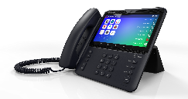
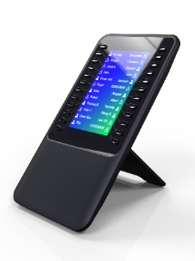
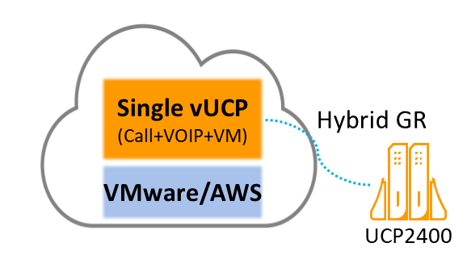
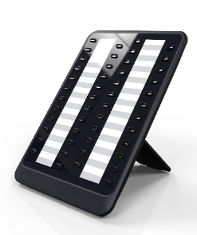








V4.1 highlight
Blue items in Unified 4.1
Support 1048ilss/EHSA V4, (1080i, 1048idss – P5)
Support enhanced versions of CCX, IP-ATD, IPCR, NMS
vUCP – Trial license, (Single instance, Hybrid GR – P5)
Integration - MS Teams interworking and enhanced SMDR interface
Enhanced features for usability, management, security, …
UCS 6.1+
CCX R+ 1.2
User Experience
Management
Security
Vertical markets
New SLTMs*
1080i*
1048ilss
1048idss*
IP-ATD 2.7A
EHSA V4
IPCR 3.2
Trial license
Single Instance*
Hybrid redundancy*
NMS 2.1
Web API / SMDR
New terminals &
Accessories
Enhanced Apps
Virtual UCP
Integration
Enhanced features
* Unified SW Phase 5

Slide 4
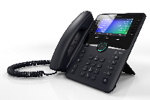
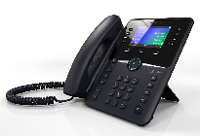
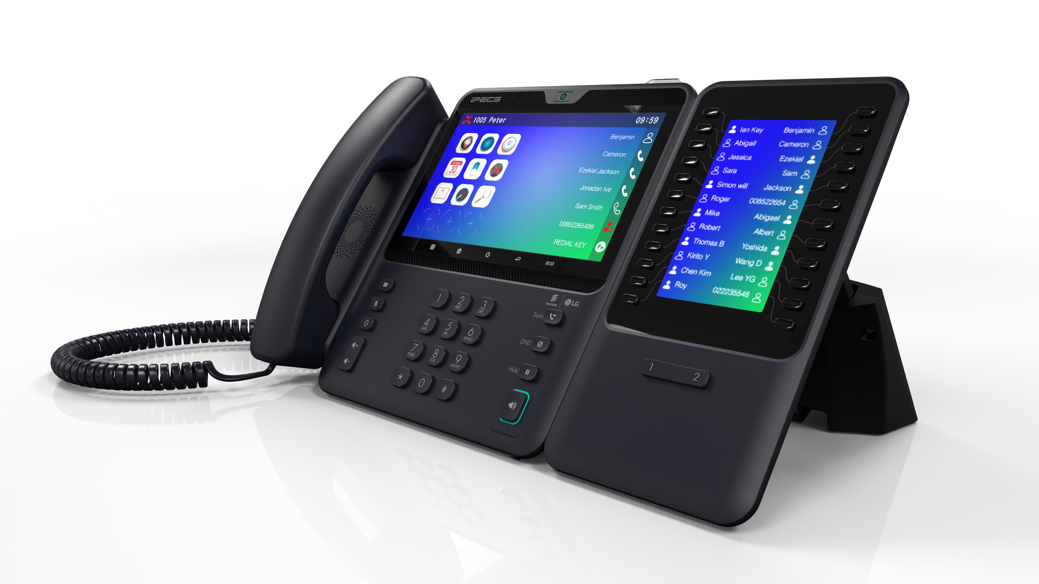
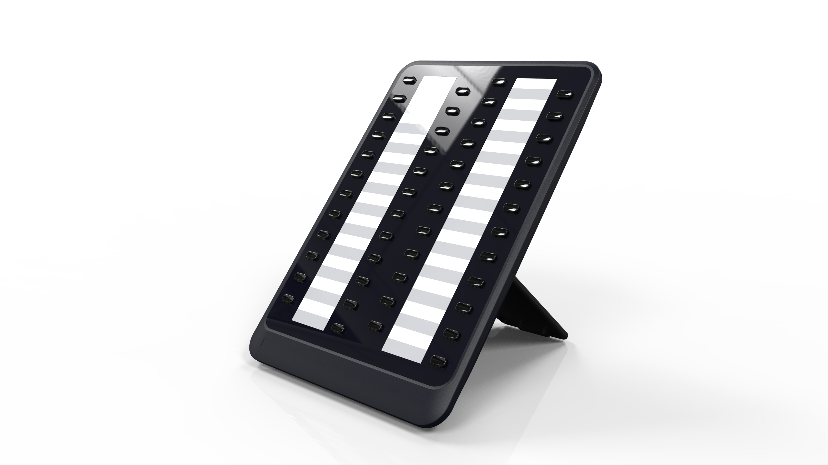
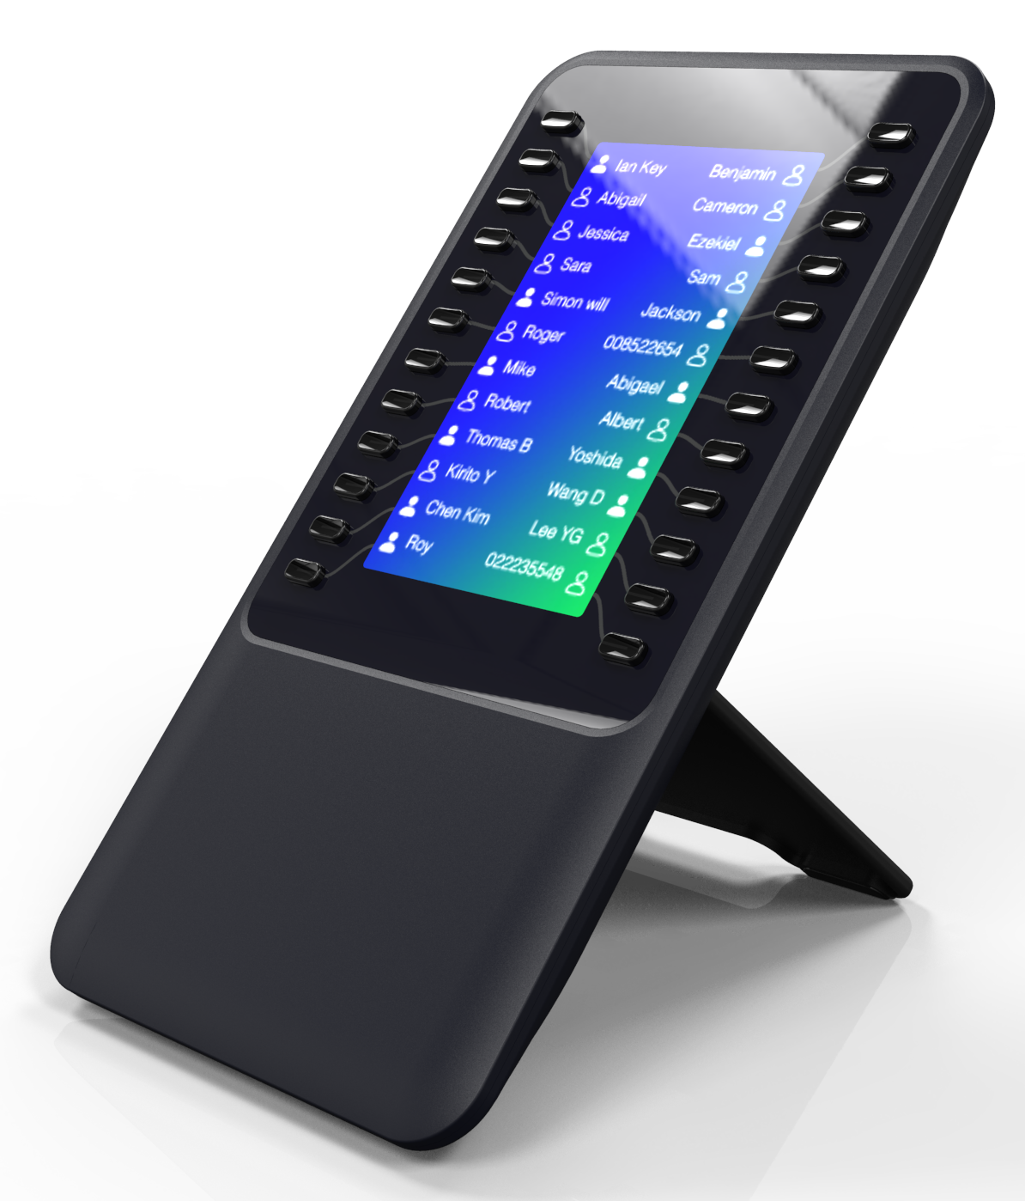
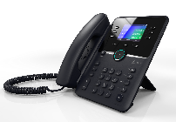
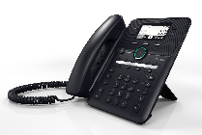
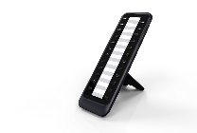
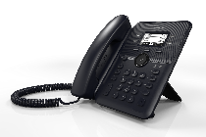
1000i support
Supporting 1000i expansion module and accessories
Unified V4.0
Unified V4.1
(Oct/2020)
Unified V5
(Q2/2021)
1050i (4.3”)
1040i (3.5”)
EHSA V4
1080i*
Android 10 OS
7” Touch screen LCD
Built-in WiFi (802.3b/g/n/ac)
Built-in BT (BT 5.0)
5M pixel camera for video
HDMI, USB, Analog headset port
Simple foot stand
1048idss*
48button paper DSS
Up to 4 ea per phone
1020i/30i/40i/50i/80i IPKTS
1030i (2.8”)
1048ilss
Color LCD DSS
24 button x 2 pages
Up to 3 ea per phone
1020i/30i/40i/50i IPKTS
1080i IPKTS (Q2/2021)
1020i (2.8”)
1010i (2.4”)
1024idss
EHSA V3
* Unified SW Phase 5

Slide 5

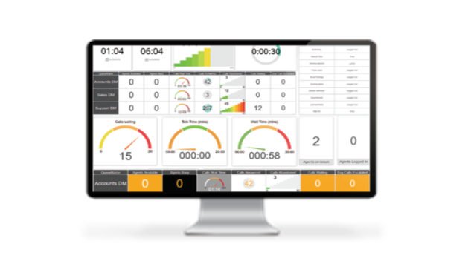


Enhanced applications
(Unified V4.1/5.0)
Support enhanced applications with enhanced UX, management and Security features
UCS 6.1+ | IP Attendant 2.7+ | CCX 1.2 | IPCR 3.2 | NMS
Mac client Catalina OS support (Jun/`20) VPN support* Android mobile client Android 10 support (Jun/`20) Mobile network IPv6 support* iOS mobile client Support iOS changed push policy* UCS Premium server Port separation for Web-admin and data transfer for UCS client* | Feature enhancement Group setting (up to 100 per group) to reduce traffic PMS event save as CSV format Caller Name Display on Queued Group Call Hiding Auth Code Change folder for Outlook Contact Sync Add Wake-Up Type (Sun~Fri) | Integration support for CCX on AWS* | Integration support for IPCR on AWS Feature support Recording cancel while auto call recording mode | Support new system/ devices eMG100 1000i LDP-9200
* Unified SW Phase 5

Slide 6
vUCP Trial Support
(Unified V4.1)
Support free vUCP trial for 90 days – need vUCP trial license.
  Applicable features and applications: vUCP call server, all system features and applications to maximum capacity
  Exceptions
    vUCP: vVOIMT/vMCIM
    Applications: CCX (no trial license), CRM for UCS (Need separate trial license for CRM for UCS)
How to get the trial license (refer to “vUCP Trial license download process” for details)
  Partner to download the following base licenses from the license portal and submit to ELG license manager to get the “vUCP-TRIAL” license.
    Base licenses (*.DAT) to download: vUCP-CS2400S, vUCP-SPLD, vUCP-MNTD-TRIAL, vUCP-MNT1
    * MNTD-TRIAL as free trial license indicator to ELG Account Manger so not to be invoiced.
  ELG license manager to provide the “vUCP-TRIAL” license.
    * vUCP-TRIAL license is valid from the date that ELG license manager generates using base license from the partner.
Install vUCP & generate S/N
Generate
base license file (*.DAT with vUCP-MNTD-TRIAL) for trial and send them to ELG license manager
ELG license manager to provide trial license (with vUCP-TRIAL)
Free trial by uploading the vUCP-TRIAL license
Use commercial version
Trial license reset request to ELG
Download the real license
Upload to the vUCP

Slide 7
vUCP Trial Support
(Unified V4.1)
Migrate trial version to commercial version before expiration
  Partner to send the trial license reset request (using “reset form” attached) to ELG license manager before expiration
  ELG to reset the trial license.
  Then, Partner can download the commercial licenses using the same serial number.
    vUCP-CS2400S, vUCP-SPLD, vUCP-MNTD, vUCP-MNT1 + required system licenses and application licenses in use (or to use).
  * System goes to the limited mode if no valid commercial licenses after trial expiration.
  ** Trial valid period can be found in the system license overview page.
  *** System to send expiring notice email (one-time notice before 30days and daily notices from 7days before expiration to pre-registered email in system Web-admin)

Slide 8

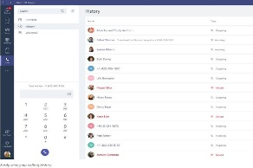
MS Teams Interworking
(Unified V4.1)
Interworking with MS Teams client through Call2Teams middleware
Support supplementary call features for MS Teams user through Call2Teams
  iPECS Phone & Teams Client pairing
  One number / Dual forking
  Make call, receive call, call transfer, call hold, call forward, mute, park, pick-up
Required licenses
  UCP/eMG
    UCP/eMG-MSTC (MS Teams Connector license, per user) for UCP/eMG as the number of MS Teams users
    SPL license as the number of MS Teams users
  Call2Teams
    Call2Teams subscription (license) per Teams user
  MS Teams license from Microsoft
    Office 365 admin account
    Office 365 E1/E3 subscription + Phone System add-on or E5 subscription per Teams user
PSTN/SIP
3rd Party
SIP Extension
Call2Teams
Middleware
iPECS UCP/ vUCP/ eMG
MS Cloud
Teams clients
with Phone System license
ELG terminals

Slide 9
Enhanced features
(Unified V4.1)
Category | Feature | Description
Integration | SMDR - ICM missed call SMDR - Called/Connected Info SMDR - Group call information SMDR - Abandoned call info SMDR Web API - Call ID SIP Paging Device | Support ICM missed call info in SMDR with call duration. Support original dialed info in SMDR for group/pick-up call. Support group call info in SMDR with answered/unanswered. Support abandoned call info in SMDR for disconnected before answer or during CCR announcement Added Call ID in SDMR Web API for call tracking Support DTMF relay during page for 3rd party SIP paging device
UX and Call management | Programmable MOH by station Transfer using DIR search Flexible paging from MEX Transfer to a station in DND/FWD Idle on Hold for CC agent Block transferring a call Ringback tone for group Multi barge-in conference | Support multiple different MOH on flexible buttons so play different MOH to caller when hold/transfer. (Number of VSF MOH is increased to 30) Support a transfer using DIR search Mobile extension can also make a flexible paging from external to system. Support transfer a call to a station in DND/FWD state using “override code”. Add an option “Go to idle on hold” specially contact center agent. Add an option to block a transfer for CO/Internal call Add more ringback tone options for group Enable barge-in conference joined by multiple users up to 32(UCP) 13(eMG)
Security/ Privacy | Web/Telnet enable/disable SMTP password digit increase DSS LED service for specific users | Support enable/disable Web/Telnet connection of phones (1000i only) by system Increased the number of digit to 64 for SMTP password (system / station) Added DSS LED service option to disable for specific stations
Management | Programming in excel style eMG800 time slot full alarm Decimal digit for mini-bar charge License for 3rd party coloring UCP100 SLIU disable option eMG800 ISDN clock sync | Added for SMTP configuration table, LCR tables eMG800 time slot full notification Support decimal digit for mini-bar charge License for 3rd party coloring solution (only for Korea) Added UCP100 disable option to use 2 SPL ports for others Added clock sync for eMG800 slave cabinets

Slide 10
Licensing update

Slide 11
License updates with Unified v4.1
vUCP-Trial license
MS Teams Connector license (MSTC) for each system
New licenses in Unified 4.1
Licenses
Hardware
Single system software
(Unified SW)
System Port License (SPL)
IP Extension
Apps & Feature licenses
SWA licenses
eMG800
10port
50port
100port
200port
UCP100
10port
50port
UCP600
10port
50port
100port
200port
500port
UCP2400
10port
50port
100port
200port
500port
1,800port
vUCP
10port
50port
100port
200port
500port
2,200port
IPEXT
(ELG
IP/SIP Phones)
3SIPEXT
(3rd party
SIP Phones)
UCP VOIP Switching
vVOIM/vVOIMT channel license
VCIM-DSPCL32 (32ch DSP)
eMG/UCP
MNTD
MNTD2/3/4/5/6
MNT1/2/3/4/5
MNTU1/2/3
Embedded VM ch/memory Exp
UVM channel/memory Exp
vUVM channel license
vMCIM channel license
UCP2400
IPN / TNLS / TNLCM
GR(Geo redundancy)
MEX
Mid
Call Server
G/W &
Accessory
CO/BRI/PRI
SLT/DKTU/
DECT
Voicemail
Conference
Cabinet
Hotel / FIDELIO
3rd PMS I/F (50 Guest room base)
TAPI
3SIPC/3SIPS
MS Lync
MSTC (MS Teams Connector)
AMSI, AMP
API-SMDR*²
API-CTI
API-CTI-EXT
API-AMP
2,400
2,400
eMG800
UCP600
1,200
vUCP
MNTD
vUCP-MNTD-TRIAL
vUCP-TRIAL
> For CS2400
MNTD2/3/4/5/6
MNT1/2/3/4/5
MNTU1/2/3
> For CS2400S
MNT1/2/3/4/5
w/SPL&EXPM
w/SPL
w/SPL
SMB
Virtual
Machine
600
600
600
UCP100
vUCP
w/SPL
199
w/SPL
eMG80
200
w/SPL
100
50
vUCP-CS2400S (SWL)
vUCP-SPLD
50
UCS User lic (Basic/Adv/Power)
UCS Premium Server license
Clickcall*¹
IP Attendant Office / Hotel
IPCR
CCX
NMS
eMG80
eMG800
UCP100
UCP600
UCP2400
vUCP
On-premise
Virtual
On-premise
Virtual
*¹ Clickcall license: Common use for current Clickcall client & new Clickcall Web API (RESTful)
*² API-SMDR: Common use of SMDR RESTful API and SMDR Web API

