Slide 1
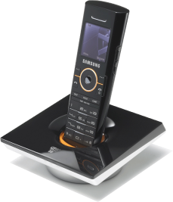
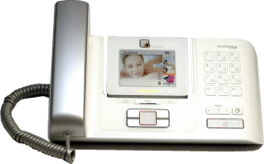
[SCM Express]
VMware
Client Configuration
Guide

Slide 2
Chapter 1. Preparation

Slide 3
1. Preparation - 1
1.1 Case 1 : VMware was installed
In this case, we should assume that VMware Client program is also installed.
You have to set up the necessary resources in using the Client program.
[SCM Virtualization resource]
See Chapter3 to set up.
구분 | SCM Express | SCM Enterprise
Virtual CPU | 2.0 GHz 4 core | 2.0 GHz 4 core
Virtual RAM | 6 GByte | 10 GByte
Virtual HDD | 300 GByte | 300 GByte
Virtual Network bandwidth | 100 Mbps | 100 Mbps
Virtual Network adapter | 3 | 3

Slide 4
1. Preparation - 2
1.2 Case 2 : VMware was not installed
1.2.1 Physical Server
[Server Resource]
(Caution)
Server resources have to be sufficient to install VMware and SCM S/W.
구분 | SCM Express 용 | SCM Enterprise 용
CPU | 2.0 GHz 5 core or more 2.9 GHz 4 core or more | 2.0 GHz 5 core or more 2.9 GHz 4 core or more
RAM | 10 GByte or more | 14 GByte or more
HDD | 300 GByte or more | 300 GByte or more
Network bandwidth | 100 Mbps or more | 100 Mbps or more
Network adapter | 1(minimum) / 3(recommended) | 1(minimum) / 3(recommended)

Slide 5
1. Preparation - 3
1.2.2 VMware Installation
VMware vSphere Hypervisor : VMware ESXi 5.5
This guide does not describe VMware installation.
1.2.3 VMware Client program installation
VMware vSphere Client :
VMware-viclient-all-5.5.0-1281650.exe
See Chapter2 to install VMware Client.

Slide 6
Chapter2. VMware
Client Installation

Slide 7
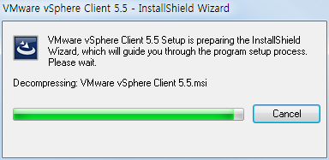
2. VMware Client Installation -1
Run installation file and select the language.

Slide 8
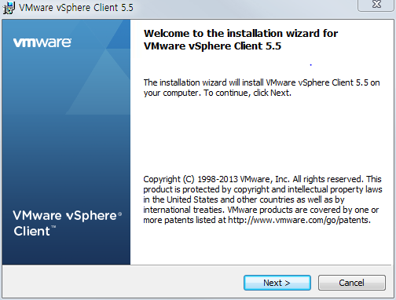
2. VMware Client Installation - 2
vSphere Client wizard start
<Next>

Slide 9
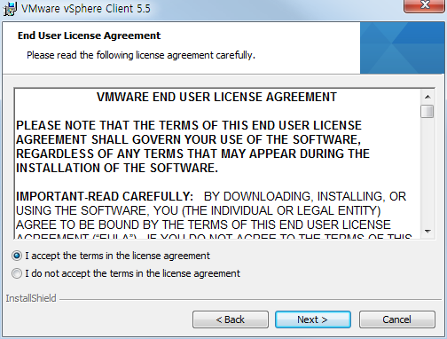
2. VMware Client Installation - 3
Select
<I accept the terms in the license agreement>
<Next>

Slide 10
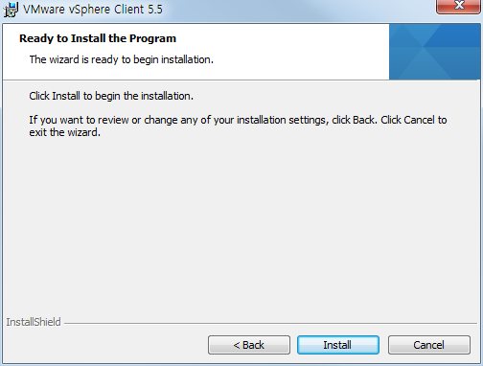
2. VMware Client Installation - 4
Select <Install>

Slide 11
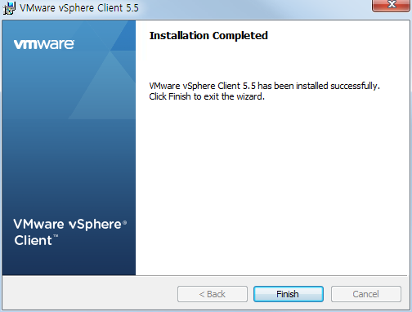
2. VMware Client Installation - 5
Select <Finish>
Run VMware vSphere Client program.

Slide 12
Chapter3. VMware
Network Configuration

Slide 13
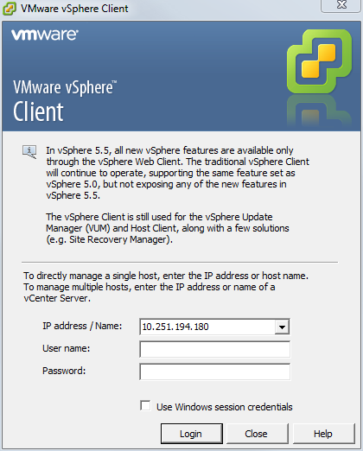
3. VMware Network Configuration - 1
Input IP address of server that is installed VMware ESXi
Input Id/Password of VMware ESXi.

Slide 14
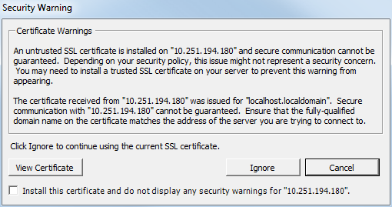
3. VMware Network Configuration - 2
In this case, select <Ignore>

Slide 15
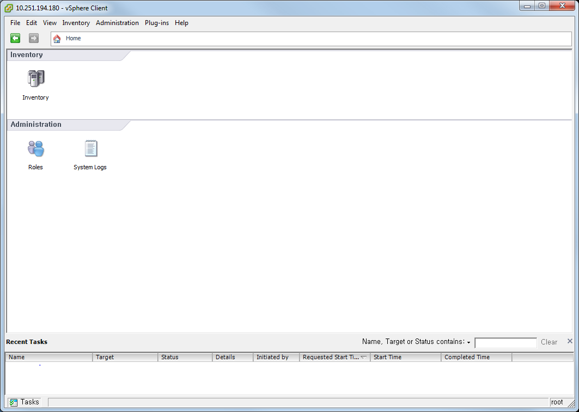
3. VMware Network Configuration - 3
Select <Inventory>

Slide 16
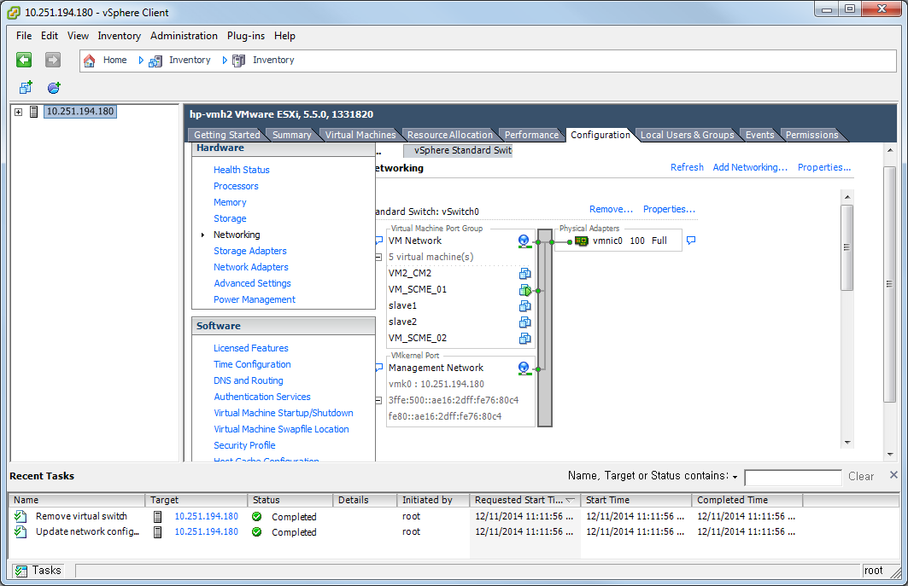
3. VMware Network Configuration - 4
Select Configuration tab
Hardware -> Networking

Slide 17
3. VMware Network Configuration - 5
If there is only the VM Network, you have to add VM Network 1~3.
If the number of available physical network adapter is 1, add VM Network 1.
If the number of available physical network adapter is over 3, add VM Network 1~3.

Slide 18
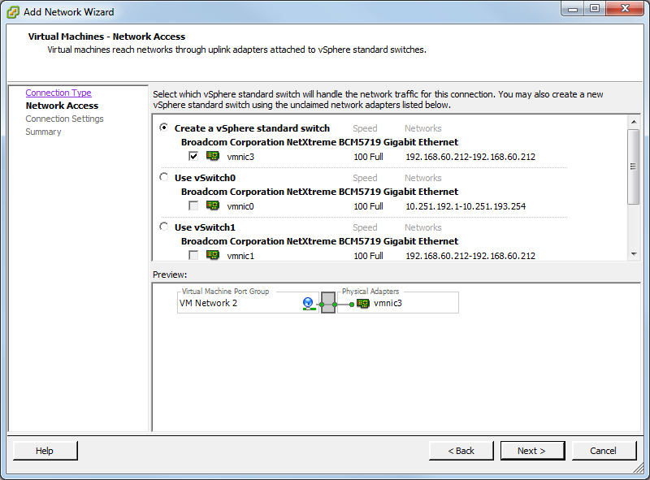
3. VMware Network Configuration - 6
1) Click Add Networking Wizard.
2) <Virtual Machine> -> <Next>
3) <Create a vSphere standard switch> -> <Next>

Slide 19
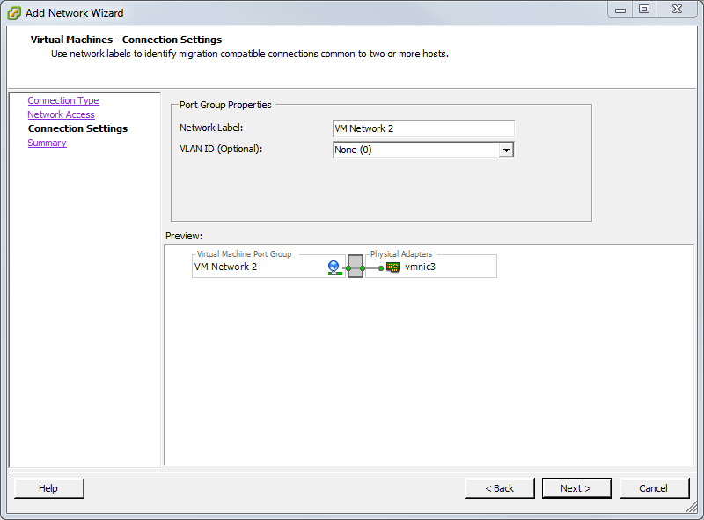
3. VMware Network Configuration - 7
4) Input <Network Label> - VM Network 1
5) <Next>
6) <Finish>
If you want to add more network adapter, Repeat 1) ~ 6)

Slide 20
Chapter4. VMware
Client Configuration

Slide 21
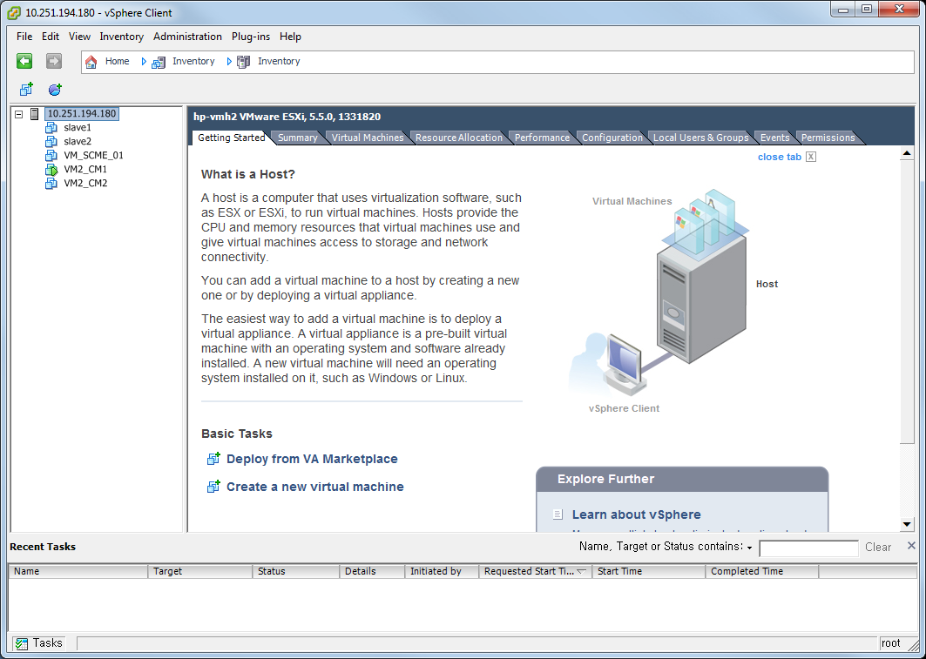
4. VMware Client Configuration - 1
File -> New -> Virtual Machine…

Slide 22
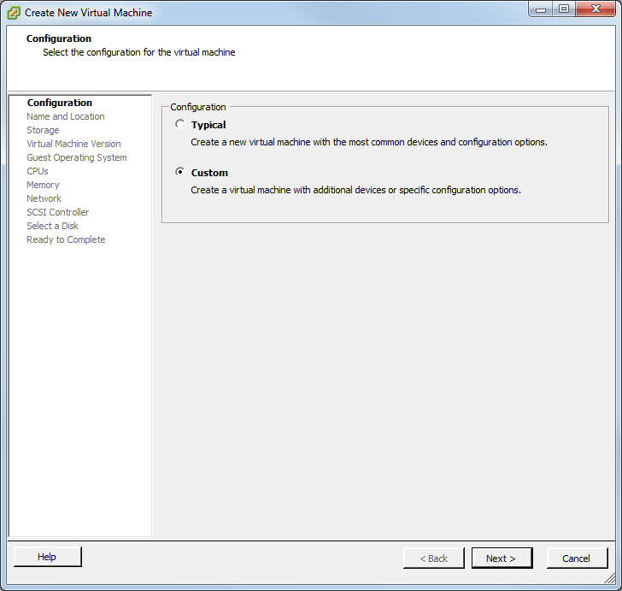
4. VMware Client Configuration - 2
Select <Custom>
<Next>

Slide 23
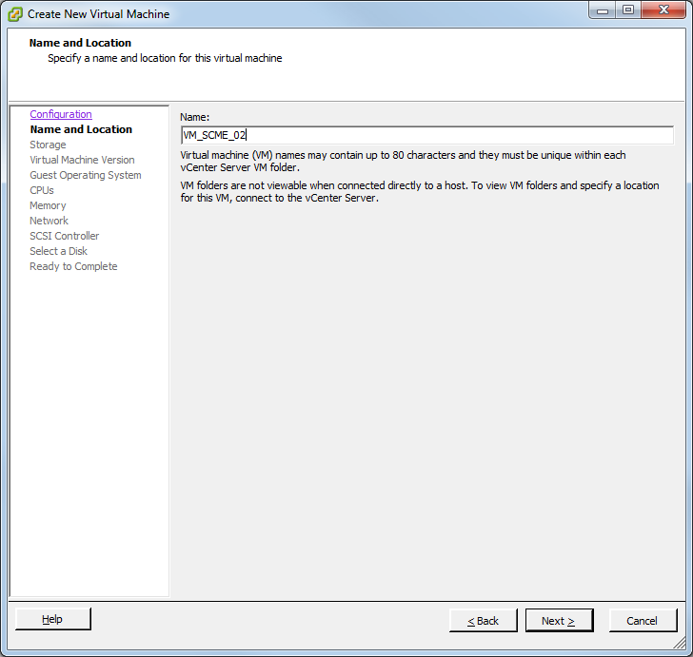
4. VMware Client Configuration – 3
Input the virtual machine name
<Next>

Slide 24
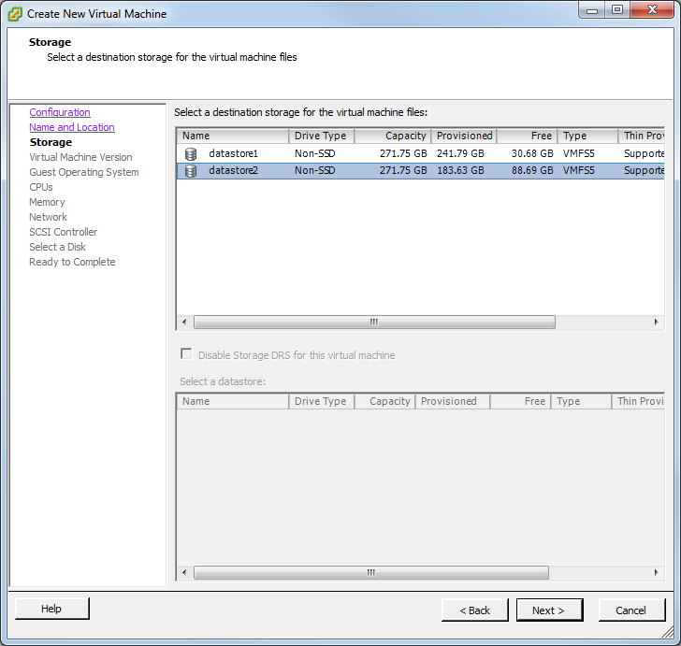
4. VMware Client Configuration - 4
Select a destination storage for the virtual machine files
<Next>

Slide 25
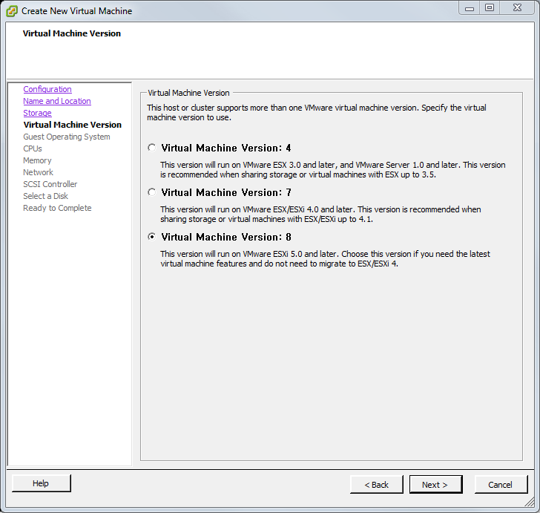
4. VMware Client Configuration - 5
Select <Virtual Machine Version : 8>
<Next>

Slide 26
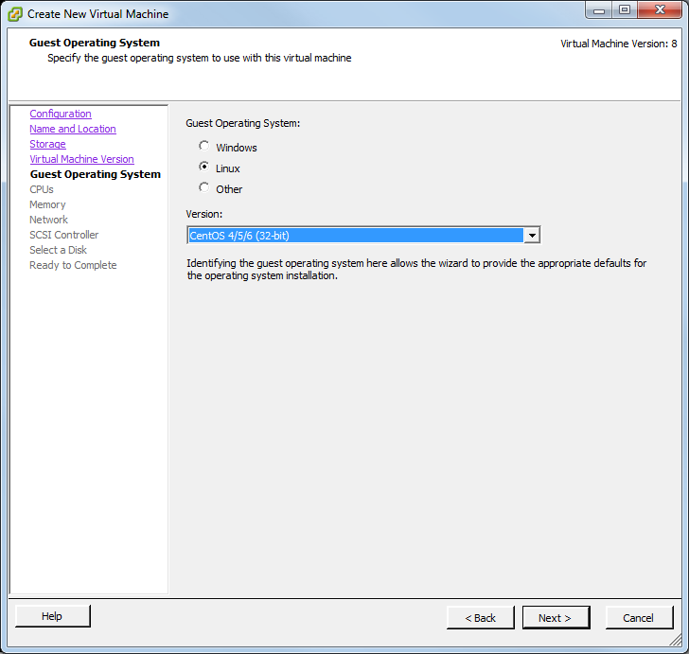
4. VMware Client Configuration - 6
Select <Linux>
Select <CentOS 4/5/6(32bit)>
<Next>

Slide 27
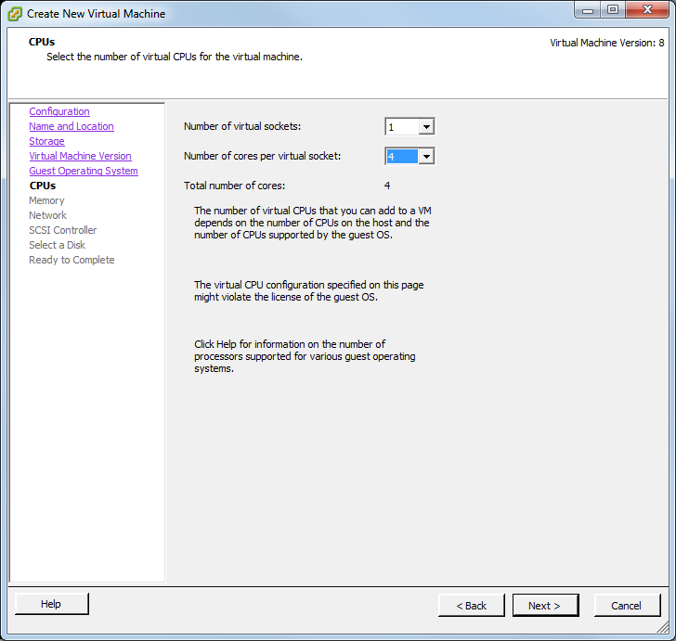
4. VMware Client Configuration - 7
Number of virtual socket : <1>
Number of cores per virtual socket : <4>
<Next>

Slide 28
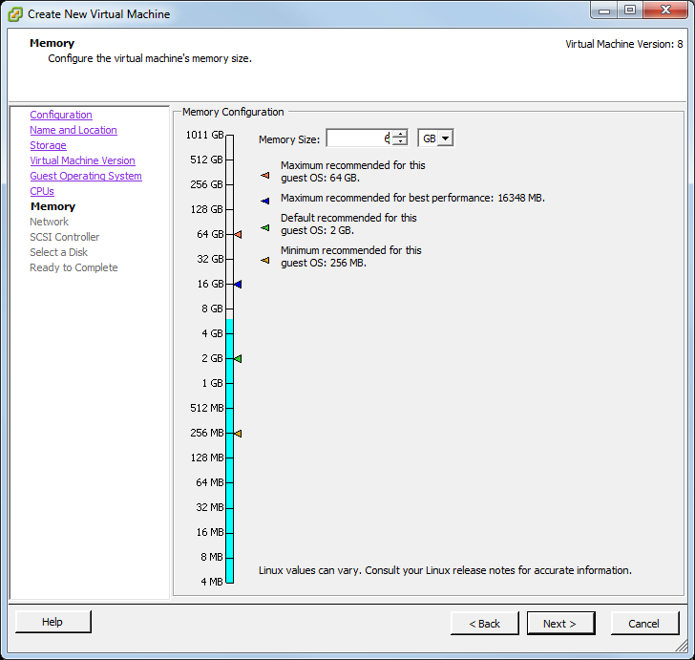
4. VMware Client Configuration - 8
Memory Size :
SCM Express : <6 GB> , SCM Enterprise : <10 GB>
<Next>

Slide 29
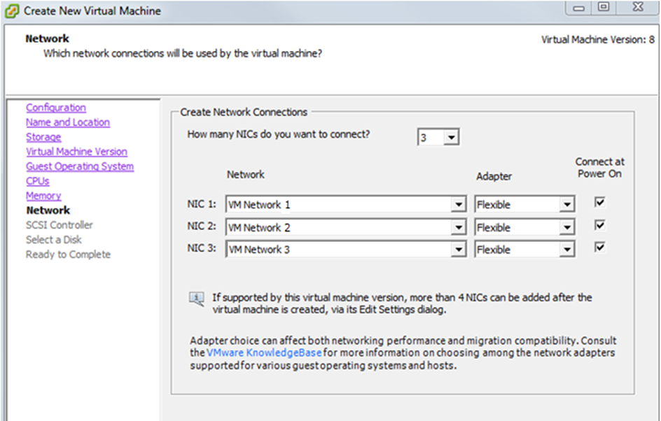
4. VMware Client Configuration - 9
Virtual Connection NIC <3>
NIC 1~3 :
Select virtual network adapters. (all same or three different)
Adapter : <Flexible>
<Next>

Slide 30
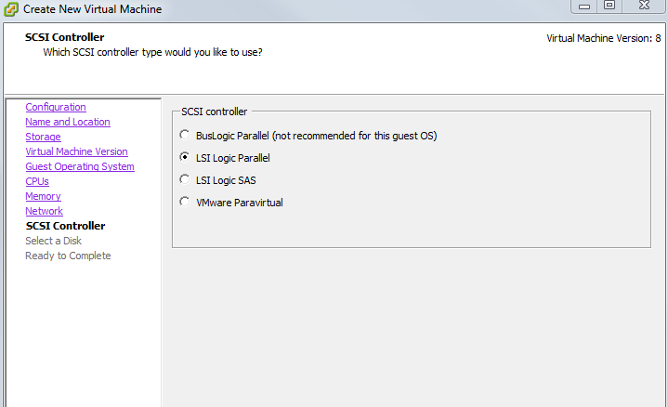
4. VMware Client Configuration - 10
SCSI controller <LSI Logic Parallel>
<Next>

Slide 31
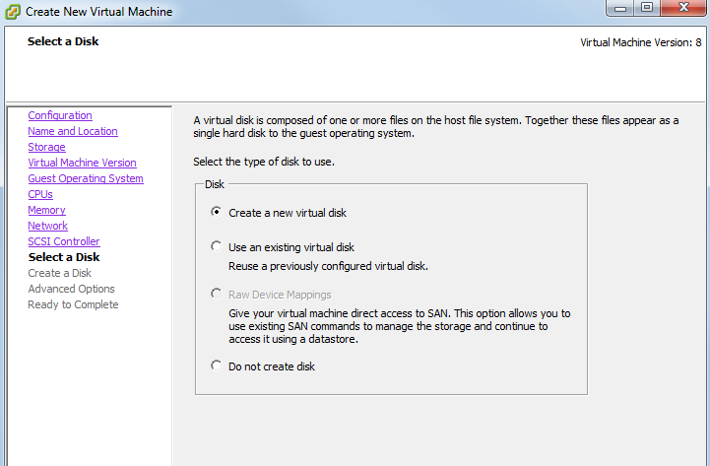
4. VMware Client Configuration - 11
Select a Disk type: <Create a new virtual disk>
<Next>

Slide 32
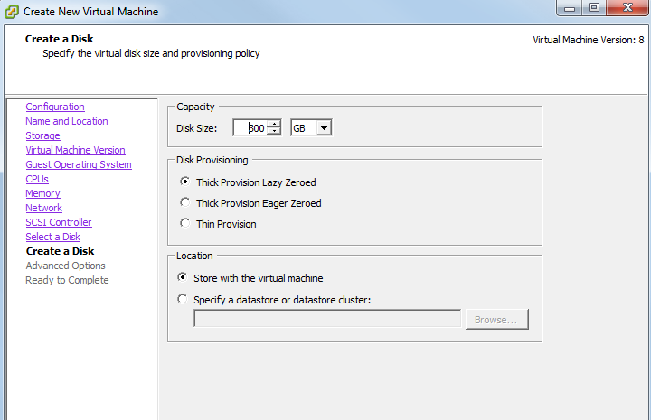
4. VMware Client Configuration - 12
Capacity : <300 GB>
Disk Provisioning : <Thick Provision Lazy Zeroed>
Location : <Store with the virtual machine>
<Next>

Slide 33
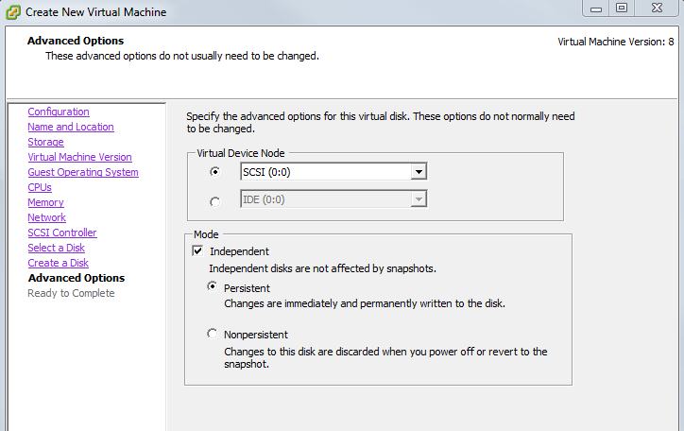
4. VMware Client Configuration – 13
Virtual Device Node : Maintain the default
Mode : <Independent> -> <Persistent>
<Next>

Slide 34
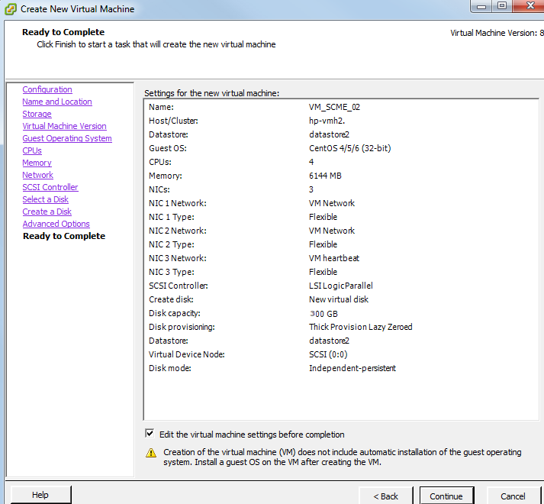
4. VMware Client Configuration - 14
Check <Edit the virtual machine settings before completion>
<Next>

Slide 35
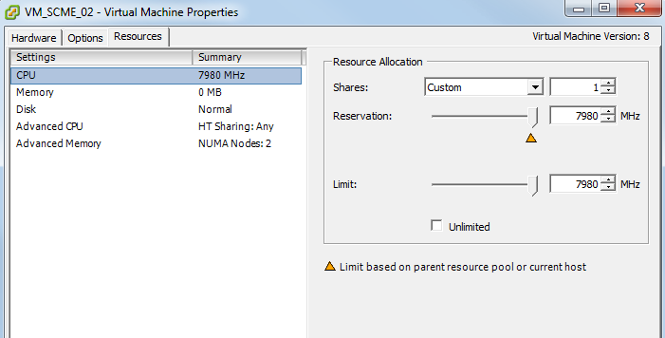
4. VMware Client Configuration - 15
Select Resource tab
Select CPU resource
Shares : Custom – 1
Limit : Uncheck <Unlimited> and scroll the max MHz
Reservation : Scroll the max MHz

Slide 36
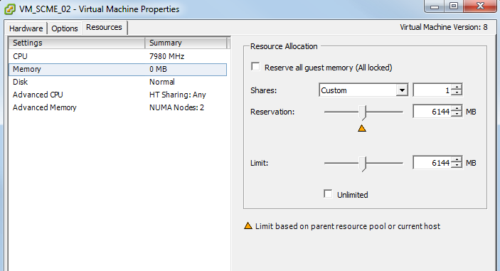
4. VMware Client Configuration - 16
Select Memory resource
Shares : Custom – 1
Reservation : Scroll the max MB
Limit : Uncheck <Unlimited> and input <Reservation value>

Slide 37
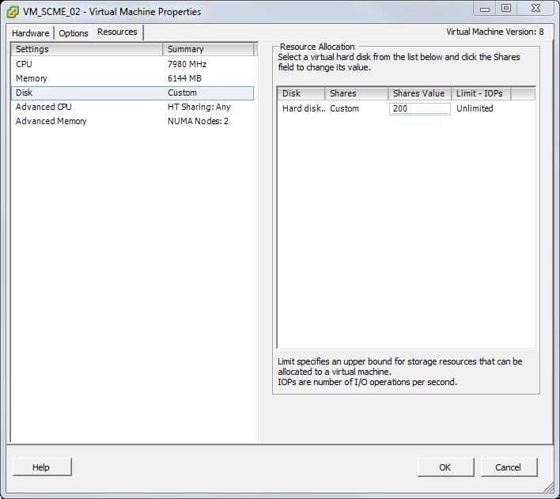
4. VMware Client Configuration - 17
Select Disk resource
Shares : Custom
Shares Value : 200
<OK>

Slide 38
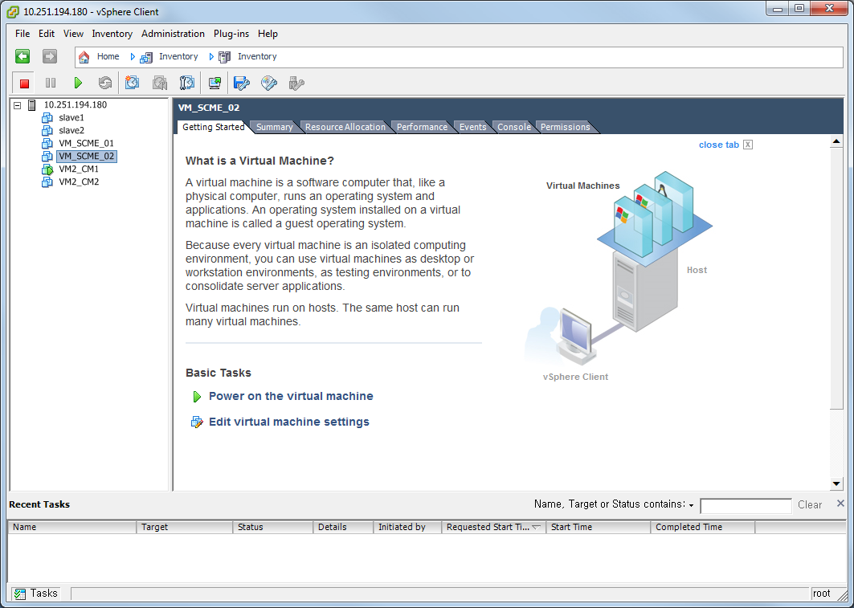
4. VMware Client Configuration - 18
Power on virtual machine
Select Console tab(Ctrl + Alt : Release console)
Icon click -> CD/DVD drive1 -> Connect to ISO image on local disk -> select SCME ISO image

Slide 39
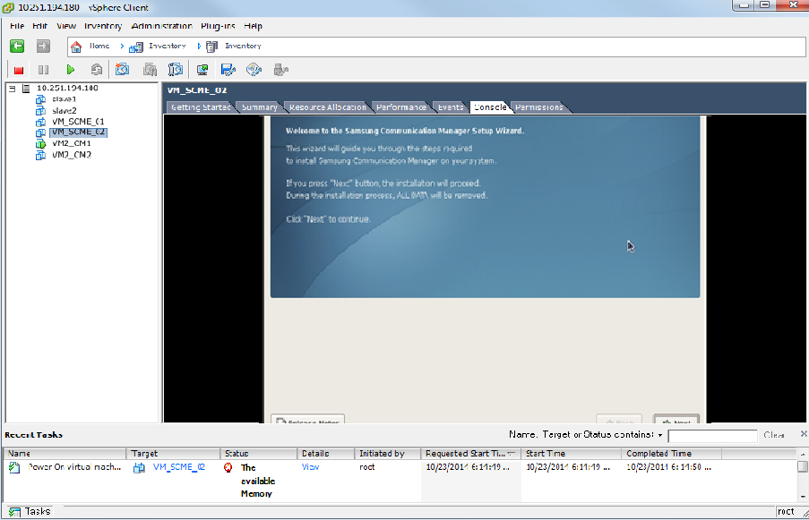
4. VMware Client Configuration - 19
Select Console tab
Install SCME
: See SCM Express_Installation Manual

